Slide 1










Eco-Emosphere
What can we learn about climate change through sentiment analysis across different social media platforms?

Slide 2
Why is this important?
Climate change is a global issue and analyzing discourse surrounding it provides valuable insights into general public attitudes, engagement, and awareness of recent and historical issues/events surrounding climate change
(Social) Shed light on how different communities perceive and engage with climate change. Understanding these disparities may indicate inequalities in climate awareness and therefore access to solutions, helping address environmental justice concerns
(Political) Can influence policy decisions and actions taken to address climate change. Positive sentiment signals public support that can suggest or fast-track climate policies, while negative sentiment presents challenges that policymakers need to address
(Geographic) Highlight geographic or temporal variations in various aspects of the climate change effect. Graphing areas with different levels of polarized sentiments or shifts in sentiment over time can offer valuable insights into regional differences experiencing localized climate change and the potential effectiveness of climate communication or campaign efforts
Notes:
Global issue…
Social issue…
Political issue…
Geographical issue…

Slide 3
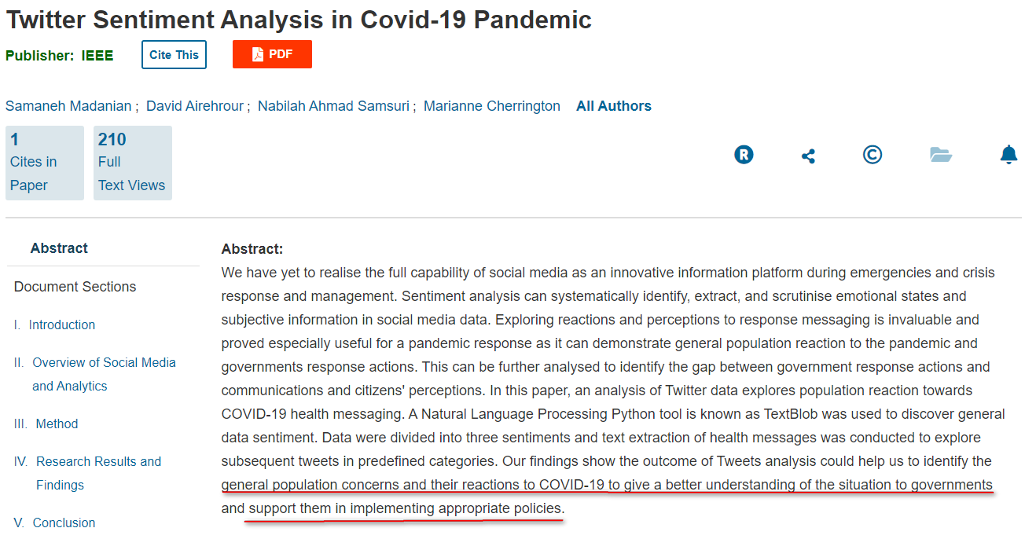
Literature Review
https://ieeexplore.ieee.org/abstract/document/9623124
Notes:
misinformation, fake news and rumours; therefore, evaluation of health promotion perception and sensitivity is necessary.

Slide 4
Why Youtube, Reddit, Facebook?
Twitter is great but limited by most recent API changes, rate-limiting (∴ small-scale) and pay-walling, APIs and even scraping wrappers are not functional. Available datasets on Kaggle need to be “hydrated”, which also require using these APIs
Comments on Youtube & Facebook and content on Reddit are predominantly text-based, which is perfect for the scope of this project as image or video would require machine learning and more time-consuming analysis. This eliminates Instagram, Tiktok, Twitch
Social media platform eliminates messaging platforms like WhatsApp, Snapchat or Discord as it is not possible to acquire information of the message content legally and infringes heavily on user privacy
These 3 are also some of the older platforms, founded around 2004-2005 respectively, thus they have a more established user-base and a reliable stream of content for the project

Slide 5
Data Period & Granularity
Arbitrarily chosen span of 4 years (1 Aug 2018 - 1 Aug 2022)
Constrained by available datasets and available time
Constrained to the same period to avoid potential confounding factors that may arise from different time periods, especially across different platforms
Focus is on COMMENTS!
Posts are generally informative (links, pictures, videos)
Greater in magnitude, providing more data
Uniformity across datasets

Slide 6
“Climate Change Reddit Comments”
How data was collected: All the posts and comments on Reddit mentioning the terms "climate" and "change", 1 Jan 2010 - 31 Sept 2022 Same dataset from Kaggle used in PS4, but comments instead of posts
How variables may be used: 'id’, ‘type’, ‘subreddit.id’, ‘subreddit.nsfw’: dropped ‘permalink’: verification purposes 'subreddit.name': gives an idea of the community ‘created_utc’ => ‘comment_date’: plot relationships vs time 'body': derive sentiments 'score': upvotes - downvotes, plot popularity of comment vs comment content
Strengths: 1) 'subreddit.name' is very useful to determining the community of users, as compared to Eg. Twitter that does not have a certain specific topic 2) As 'score' is net (upvotes - downvotes), it can be negative, which then can be interpreted as an unpopular, rejected opinion. This is in contrast to platforms like Facebook/Twitter that has no “dislike” option 3) 4 million data values
Limitations: 1) ‘created_utc' requires conversion back into YYYY-MM-DD format
Agenda
Bonus

Slide 7

“Facebook”
How data was collected: Facebook-scraper library used to scrape for all comments on the UNclimatechange page (513k followers), NASAClimateChange page (1.3m followers), Climate Change – open discussion group (7.5k members)
How variables may be used: ‘comment_url’ => ‘link’: verification purposes ‘comment_time’ => ‘comment_date’: plot relationships vs time ‘comment_text’ => ‘body’: derive sentiments ‘comment_reaction_count’ => ‘likes’: Taken entirely as likes for simplification, as exact reactions are not returned in results and majority (4/6) are positive emotions, with the default being “like”, plot popularity of comment vs comment content
Agenda
Bonus

Slide 8
“Youtube”
How data was collected: Briefly, 1) Search to search term “climate change” => list of videos with videoIDs 2) CommentThread to extract all commentThreads (top-level comments) per videoID 3) Comments to extract all nested replies per commentThread (API limitation: replies only to top-level comments, not replies to replies yet) How variables may be used: ‘videoId’ => ‘link’: verification purposes ‘updatedAt’ => ‘comment_date’: plot relationships vs time ‘textDisplay’ => ‘body’: derive sentiments ‘likeCount’ => ‘like_count’: number of likes, plot popularity of comment vs comment content
Strengths: 1) Although comments are text-based, these comments are in response to purely audio-visual content, affecting comments in a different way 2) Less moderation, allowing more diverse and extreme/heterogenous opinions
Limitations: 1) Youtube is a Google service, thus requires authorization and verification via Google accounts before posting any comments, as opposed to Reddit not requiring actual verification despite the “Email” field. This might mean expressions and opinions are more candid and filtered.
Agenda
Bonus

Slide 9
In-depth: Youtube Search API
Parameters | Value | Rationale
part* | “snippet” | -
q | "climate change“ | Topic
order | ”relevance”/”viewCount” | relevance: Most relevant content to climate change viewCount: Greater views allow for greater comments and greater diversity of sentiments
publishedBefore | 2022-08-01T00:00:00Z | Constraint
publishedAfter | 2018-08-01T00:00:00Z | Constraint
safeSearch | none | Return maximum amount of unfiltered content for analysis
maxResults | 50 | Return maximum number of items in the result set

Slide 10
In-depth: Youtube CommentThread API
Parameters | Value | Rationale
part* | “snippet” | -
videoId | (from previous part) | -
order | ”relevance” | Most relevant content to climate change
maxResults | 100 | Return maximum number of items in the result set
In-depth: Youtube Comments API
Parameters | Value | Rationale
part* | “snippet” | -
parentId | (from previous part) | -
maxResults | 100 | Return maximum number of items in the result set

Slide 11
How can we go about analyzing our data?
Guiding Lens
Temporal | How does the general sentiment surrounding climate change, change over time? What might be the events that coincide with a particularly interesting movement in the graph? How might we match events with a movement? Given that People’s responses to events are only at best during, and mostly after-the-fact How long an event is talked about afterwards proportional to significance of an event Google plausible events ⇌ Compare with data
Social | What areas of climate change are people most and least interested in or concerned about? Does Google Search Interest complement the findings?
Geographical | Are there any discrepancies in these topics of interest with regards to the region?
Political | How does politics play a part in this?
“People in this (region), mostly (community/group), are more concerned with (aspect of climate change) around (time). This could be because of (a certain event around this time)…”
Notes:
Ideally, we can have our model answer as such

Slide 12
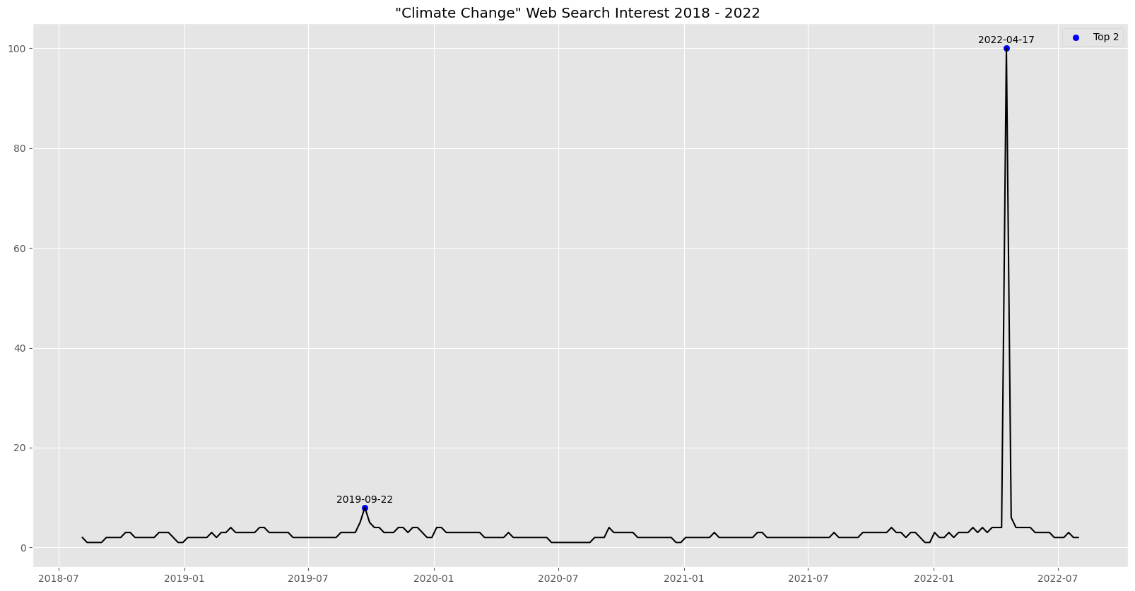
Google Search Interest (Relative)
What happened in 22 September 2019 and 17 April 2022?
Notes:
Here’s a plot of Google Search Interest which are relative, not absolute values.
We will cover what happened in these 2 interesting periods here.

Slide 13
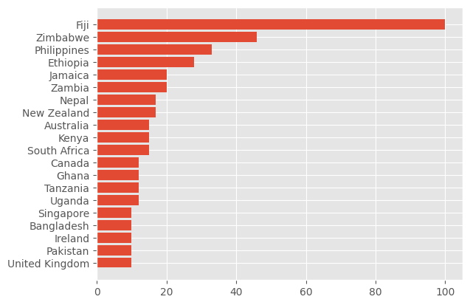
Google Search Interest by Country (Relative)
Fiji? Zimbabwe? 🤔
Unexpected?
Notes:
We can plot relative interest by country

Slide 14
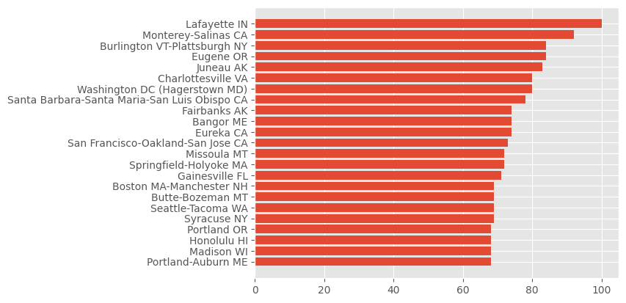
Google Search Interest by Metro (Relative)
Notes:
metro

Slide 15
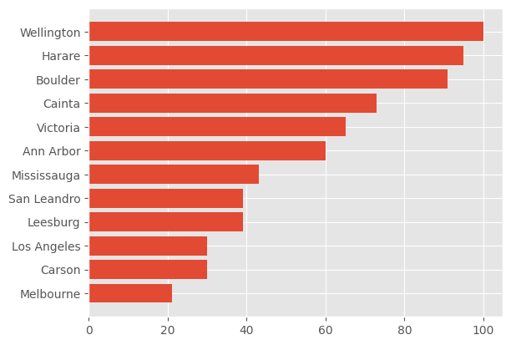
Google Search Interest by City (Relative)
(New Zealand)
(Zimbabwe)
(Philippines)
(Canada)
(Australia)
Notes:
Cities
Most are in the U.S, but those that are not are annotated

Slide 16
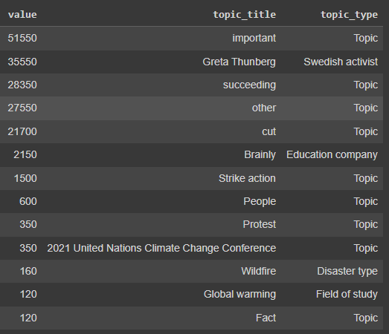
Google Search Related Topics to “Climate Change” (Absolute)
Brainly is an education platform where people can ask questions, similar to Quora
What is significant about 2021 UN Conference?
Notes:
You see Greta Thunberg, strikes, protests, and also Brainly and the 2021 UN CCC. Preliminarily, Brainly … We will see what is significant about the 2021 UN Conference later.

Slide 17
So what happened in this time frame?
Brexit
Intergovernmental Panel on Climate Change (IPCC) Sixth Assessment Report (AR6)
#BLM
Covid
Cryptocurrency & Businesses
Presidential Elections
Covid Vaccinations
Russia invades Ukraine
A few summits
LOTS of disasters (Hurricane Florence, Australia bushfires, Cyclone Fani, Suez Canal)
Notes:
Before we dive right in, I’d like to briefly go over what happened in this time frame …
Some may seem to have nothing to do with climate change, on a superficial level. And they may not, but we can’t be sure of that yet

Slide 18
Politics
Climate
So what happened in this time frame?
*Not exhaustive
Date | Event
August 1, 2018 | Apple Inc. becomes the first publicly traded company to reach a $1 trillion market cap.
August 4, 2018 | A 6.9 magnitude earthquake strikes Lombok, Indonesia, killing over 560 people and injuring thousands.
August 30, 2018 | The U.S. government announces a revised trade deal with Mexico, replacing NAFTA with the United States-Mexico-Canada Agreement (USMCA).
September 14, 2018 | Hurricane Florence makes landfall in the Carolinas, causing widespread damage and flooding.
October 8, 2018 | The Intergovernmental Panel on Climate Change releases a report warning of catastrophic consequences if global warming exceeds 1.5 degrees Celsius.
November 11, 2018 | The 100th anniversary of the end of World War I is commemorated in various countries around the world.
December 1, 2018 | The G20 Summit in Argentina ends with a commitment to fight climate change, but the United States remains non-committal.
January 14, 2019 | Zimbabwean President Emmerson Mnangagwa announces a fuel price increase, leading to protests and a violent government crackdown.
February 27-28, 2019 | North Korea–United States Hanoi Summit ends abruptly without a denuclearization agreement.
March 29, 2019 | The United Kingdom formally triggers Article 50 to begin the process of leaving the European Union (Brexit).
April 15, 2019 | The Notre-Dame Cathedral in Paris, France, suffers a major fire, causing significant damage to the structure.
May 3, 2019 | Cyclone Fani makes landfall in Odisha, India, causing extensive damage and the evacuation of millions.
September 14, 2019 | Houthi rebels in Yemen claim responsibility for drone attacks on Saudi Arabian oil facilities, disrupting global oil supply.
September 20, 2019 | Millions of people participate in global climate strikes, inspired by climate activist Greta Thunberg.
October 3, 2019 | Ecuadorian President Lenín Moreno repeals fuel subsidy cuts, ending nationwide protests.
December 18, 2019 | President Donald Trump is impeached by the U.S. House of Representatives on charges of abuse of power and obstruction of Congress.
December 26, 2019 | Australia experiences devastating bushfires, causing widespread destruction and loss of wildlife.
Notes:
I also manually collated a list of notable events that occurred in this period, note that it is not exhaustive and it’s color coded by politics or climate change.
So around 20 September 2019, Greta Thunberg happened

Slide 19
Politics
Climate
So what happened in this time frame?
*Not exhaustive
Date | Event
March 11, 2020 | The World Health Organization declares COVID-19 a global pandemic.
May 25, 2020 | George Floyd is killed by a police officer in Minneapolis, Minnesota, leading to widespread protests against police brutality and racial injustice. #BLM movement
July 15, 2020 | Twitter experiences a massive security breach, with high-profile accounts being hacked to promote a Bitcoin scam.
November 3, 2020 | The United States holds a presidential election, and Joe Biden defeats Donald Trump.
December 14, 2020 | The United States administers its first doses of the Pfizer-BioNTech COVID-19 vaccine.
January 6, 2021 | A pro-Trump mob storms the U.S. Capitol, resulting in five deaths and disruptions to the electoral vote count.
January 22, 2021 | The Treaty on the Prohibition of Nuclear Weapons enters into force, but major nuclear powers do not sign it.
March 23, 2021 | The Suez Canal is blocked by the Ever Given ship, causing a significant maritime traffic jam.
April 22, 2021 | The United States commits to reducing greenhouse gas emissions by 50-52% below 2005 levels by 2030.
November 1, 2021 | At the COP26 climate summit, nations agree to stronger emission reduction targets but critics say it doesn't go far enough.
January 15, 2022 | Tonga experiences a massive underwater volcano eruption, leading to tsunami warnings across the Pacific.
February 24, 2022 | Russia invades Ukraine, launching attacks across the country. It sparks global outrage and support for Ukraine.
September 8, 2022 | Queen Elizabeth II, the longest-reigning British monarch, dies at age 96.
October 26, 2022 | Kanye West stokes outrage with anti-Semitic comments, losing business deals.
November 28, 2022 | Elon Musk takes over Twitter in a contentious $44 billion deal.
February 6, 2023 | Turkey and Syria rocked by massive earthquakes causing thousands of deaths and widespread destruction.
Notes:
Yet Greta Thunberg wasn’t as significant on “climate change” google searches as opposed to Russia’s invasion on Ukraine around end February 2022?

Slide 20
Overall Workflow
For each of Reddit & Youtube,
Mine the comments to gather textual data
Exploratory Analysis + Topic-modelling
Lexicon-based Sentiment (AFINN, NRC)
Preprocessing
Lowercase
Removal of stopwords, punctuation, digits, foreign characters/symbols
Lemmatization
Not nuanced
"This is bad" = "This is very bad" = "This is not bad" = "bad" = -3.0
Not comprehensive
“happy” = “happier” = 3.0
“happier” = 0 / NA
Notes:
Not nuanced:
this could be why Ernest's grp exploring sleep quality in relation to temperatures & Umang's regarding cryptocurrency on Tuesday had overwhelmingly positive sentiments
(nuance) not bad meaning neutral but sentiment will be negative, (model) not good meaning bad but sentiment will be positive

Slide 21
Overall Workflow
4. Sentence-based Sentiment (VADER + Flair)
VADER:
Rule-based, no ML calculates polarity based on words from lexicon + language rules (modifiers, negations, contractions, punctuation, word-shape (CAPS), some slangs (Eg. sux, lol, friggin, kinda), emoticons, emojis)
However, currently lacks detection of sarcasm/irony/mispellings
Flair:
Embedding-based, Pre-trained ML model built on PyTorch
Embedding: numeric vector input such that words with similar meanings have the same representation. ∴ Can approximate meaning and represent words in a lower dimensional space.
∴⬇️speed, ⬆️accuracy
No preprocessing, wholesale!
5. Perspective API
For extremely negative sentiments based on step 4 => (VADER < -0.9) & (flair < -0.9)
Further analyse specific aspect of negativity

Slide 22
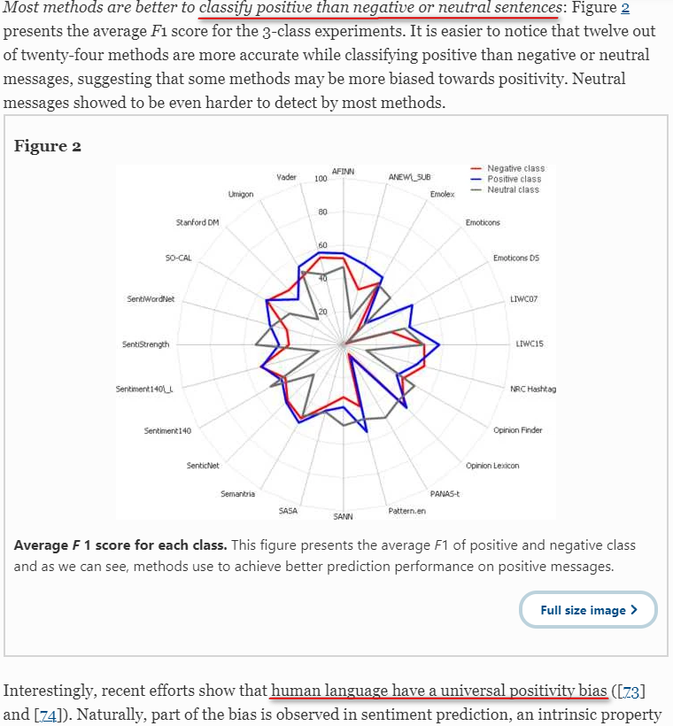
Literature Review
Sentibench

Slide 23
Peculiarity/Investigation Workflow
Plot relevant graph (Number of comments vs Time / Subreddit vs Number of comments / etc)
Vader & Flair for Sentiment vs Time
Highlight highest few and lowest few
Narrow down to fewer (1/2) periods of interest
Vader for Subreddit vs Sentiment
Zoom in on some extreme/polar comments from the periods from 2.
Notes:
This could be anything, like … just for us to understand what we’re working with, and gather some general insights about our peculiarity
Use Sentence-based sentiment analysis models (VADER) and Flair for these peculiarities as they are more accurate as opposed to lexicon ones
I chose Vader here as it is much faster and gives comparable performance on average to Flair

Slide 24
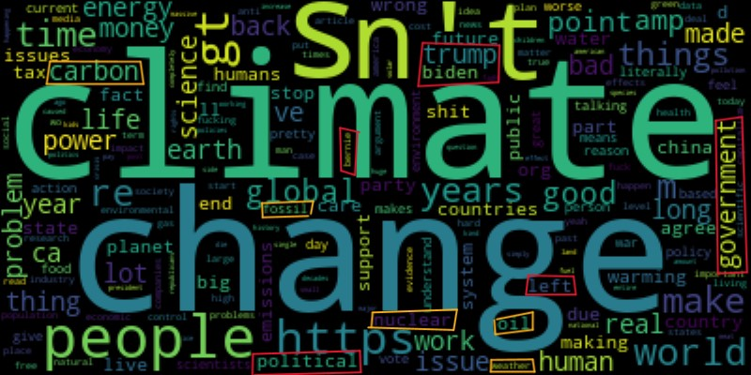
Reddit
Exploratory Analysis
Notes:
Alright! Data!
We start off with an exploratory analysis on reddit.

Slide 25
Reddit
Exploratory Analysis
WordCloud visualization
No lemmatization, just removal of stopwords
Size of word proportional to frequency of usage
Provides an overview of the raw data
Political terms/persona (government, left, trump, biden, bernie)
Climate change is a very political issue
Presidential elections in 2020 is within our period of analysis. Bernie Sanders was a Democratic candidate whose campaign advocated for aggressive action to address climate change. It highlighted the "Green New Deal," a comprehensive plan that aimed to transition the U.S. to 100% clean energy by 2050
Let’s see just how central Sanders was to climate change especially during this election period
Cause & Effects of climate change (carbon, fossil, nuclear, oil, weather)

Slide 26
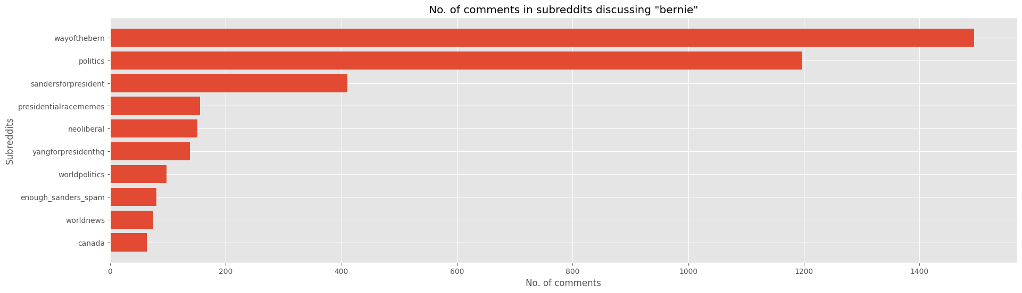
Reddit
Exploratory Analysis
Apparently there’s a subreddit “wayofthebern” dedicated to discussing about Sanders?
Politically motivated (subreddit “politics” and “sandersforpresident”)

Slide 27
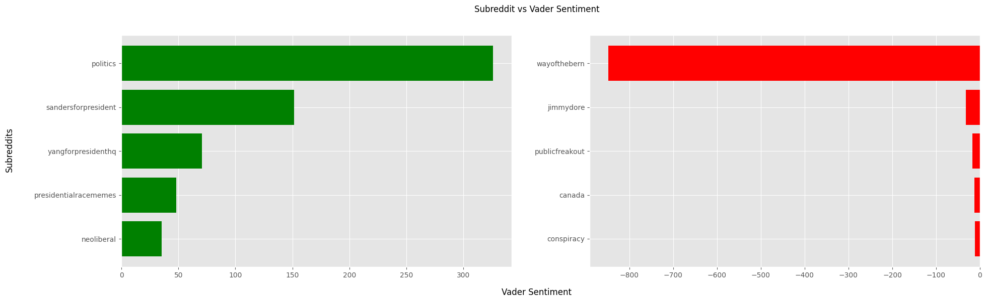
Reddit
Exploratory Analysis
Surprisingly, many divided/unpopular opinions or hate in “wayofthebern”?
How is Sanders related to Andrew Yang? (“yangforpresidenthq”)
Let’s explore a few comments in detail

Slide 28
Reddit
Exploratory Analysis
Surprisingly, many divided/unpopular opinions or hate in “wayofthebern”?
Many comments discussing Sanders discusses Biden too
Isolating to just “bernie” however, reveals more positive sentiments
Comment_date | Comment | Score | Analysis
2020-09-13 | Neither are doing single payer healthcare, and neither are doing a Green New Deal… You can't even offer us Bernie anymore, because he's shown his true colors as a corporate lapdog. | 30 | Some believed the Democratic Party coordinated against Bernie, and pushed for Biden Some criticized Bernie for endorsing Biden after dropping out of the Democratic primary
Notes:
Focus will be on the Analysis column, but you can read the comment too if you have fast eyes

Slide 29
Reddit
Exploratory Analysis
How is Sanders related to Andrew Yang? (“yangforpresidenthq”)
Yang was also a Democratic candidate, declaring himself the “younger, fresher, more modern, more Asian version of Bernie.”, and advocated for very similar causes, essentially attracting the same types of voters at his campaign stops => support for Yang ≈ Sanders
Comment_date | Comment | Score | Analysis
2020-02-12 | Well for climate I don’t like bernie because he’s against nuclear energy. That being said, he is more green energy than trump, so do with that what you will. | 1 | Why Yang is supported: Nuclear energy: Sanders against, Yang for
2020-01-03 | Completely agree, after all just look at Germany. It is closing it's nuclear power, and is now going to coal. It's so, so scary that people think Bernie has a chance at solving climate change by destroying the very solution. | 70
2020-01-30 | none of the candidates has a more suitable plan to fight climate change. thats why greenpeace and others have endorsed (bernie’s) plan… the fact you claim that some random dude can win vs trump instead of the most popular politician with the biggest grass roots support is beyond me | -16 | Why Sanders is supported: People look to official endorsements Eg. Greenpeace for evaluating candidate’s climate change proposals (Sanders aced, Yang got a C+) Grassroots support

Slide 30
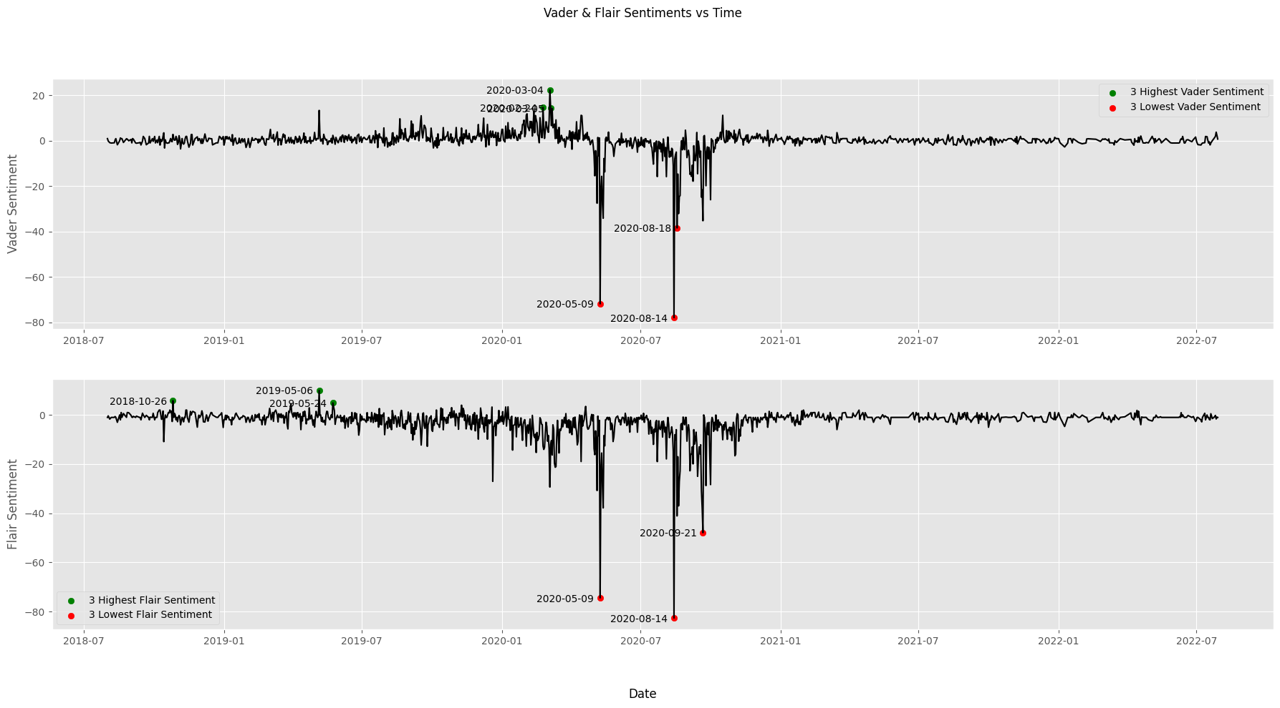
Reddit
Exploratory Analysis
Why such negative sentiments surrounding Sanders on 9 May 2020 and again on 14 August 2020?

Slide 31
Reddit
Exploratory Analysis
Why such negative sentiments surrounding Sanders on 9 May 2020 and again on 14 August 2020? Around 9 May 2020, Biden became the presumptive Democratic presidential nominee after Sanders suspended his campaign. Democratic National Convention held 17-20 August, which is the presidential nominating convention for the Democratic Party
Comment_date | Comment | Score | Analysis
2020-05-09 | …Biden is against cannabis legalization, votes for every war, made getting out of debt harder for poor people, helped write the unconstitutional Patriot Act, and racist crime bill, helped fund the border camps, said Roe vs Wade went "too far", oh yeah and he's also a rapist. So, no, Joe Biden doesn't seem any better than Trump. Biden is also: is guilty of nepotism towards his disappointing, smooth-brained family members incoherent babbling about random topics in press conferences unfocused rage and meanness/bullying toward those who oppose or challenge him multiple rape accusations as well as open displays of misogyny/groping women in public slavish devotion to banks and credit card companies despite claiming the opposite in campaign rhetoric opposed to healthcare reform sick **** that loves droning innocent people in war engineered coups in foreign countries to install puppet regimes that support their administration open hostility toward black people open antipathy toward immigrants, especially Latinos, and oversaw a regime that kept them separated from their kids, and in filthy cages in concentration camps supports spying on the American people supports throwing whistleblowers and journalists in prison … | * | Out of 92 comments that day, 87 were duplicates that were copy-pasted into many subreddits, but mostly “wayofthebern”
Notes:
…
Since the sentiment was the most negative on 14 August, we can speculate that this user’s agenda was probably to fear-monger, and might have been a Trump supporter, but we definitely know he wasn’t a Biden supporter.
Okay! We’re straying a bit from climate change, but this emphasizes the political aspect of climate change right? Moving back on track…

Slide 32
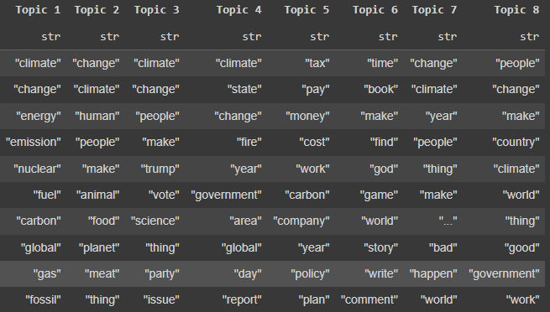
Reddit
Topic Modelling
Energy sources
Meat
Veganism
Politics
$$

Slide 33
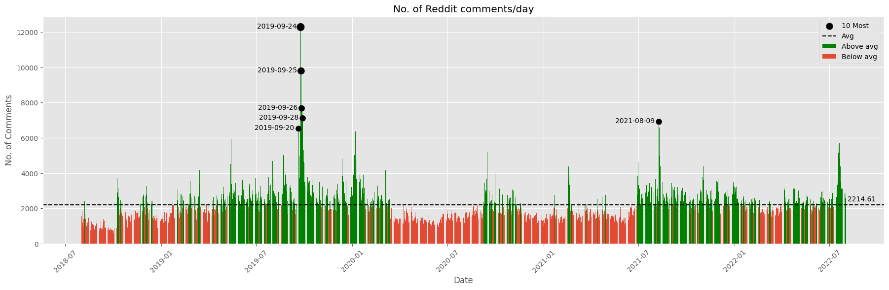
Reddit
Exploratory Analysis
Woah, what was going on around 20-28 September 2019 and 9 August 2021?
We will take note of these 2 interesting periods for further inspection.
Notes:
I aggregated the total volume of comments daily and around 20-28 September of 2019, the number of comments exploded right, and also 9 August of 2021.

Slide 34
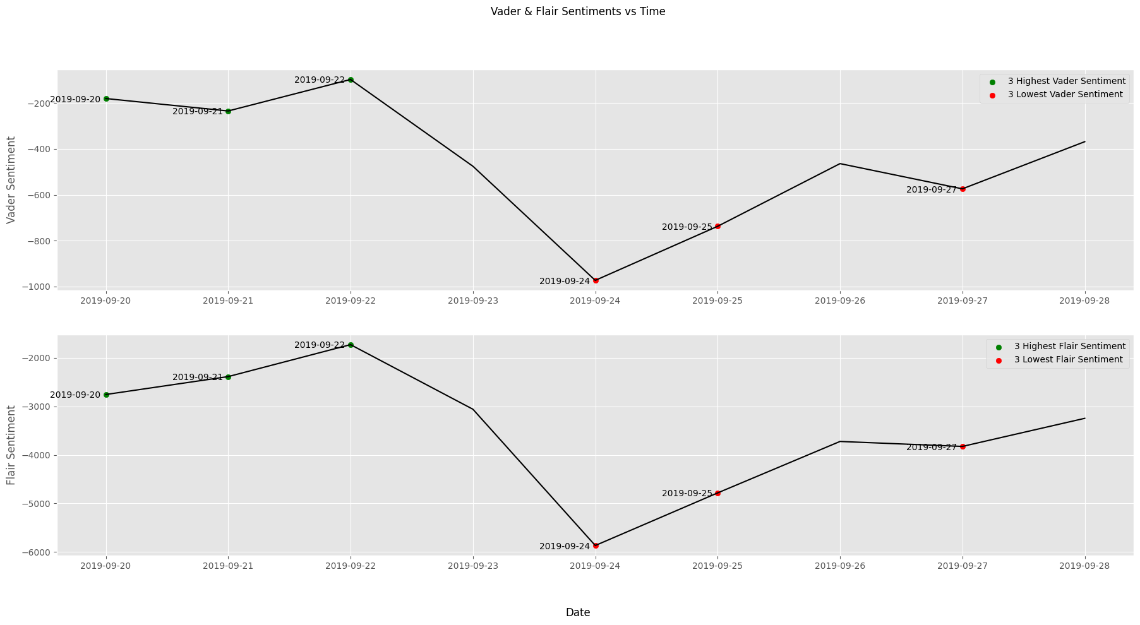
Reddit
Exploratory Analysis
Both Vader and Flair agree that sentiment was extremely negative, finally bottoming on 24 September 2019
Notes:
We

Slide 35
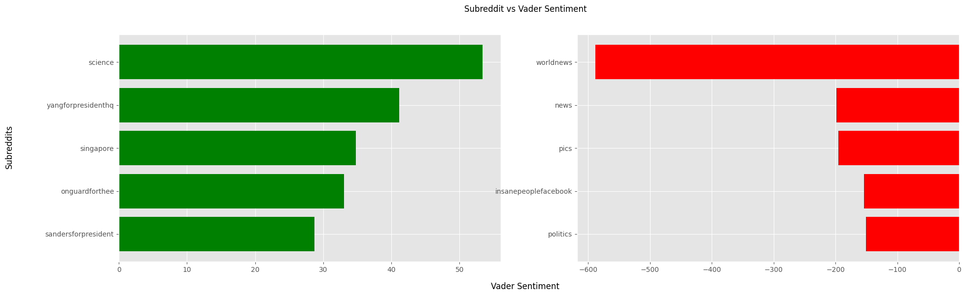
Reddit
Exploratory Analysis
20-28 September 2019: “worldnews”, “news” extremely negative. What happened?
Notes:
Looking at where the action might have been taking place, we see majority of negative sentiment came from “worldnews”. So what news exactly?

Slide 36
Reddit
Exploratory Analysis
20-28 September 2019: “worldnews”, “news” extremely negative. What happened?
September 20, 2019 | Millions of people participate in global climate strikes, inspired by climate activist Greta Thunberg.
Comment_date | Comment | Score | Analysis
2019-09-24 | “The largest greenhouse gas emitters in the world — China, the United States, and India — offered either nothing or very little about their commitments to curb emissions on Monday at the United Nations Climate Action Summit, a gathering explicitly convened to push countries to do more to fight climate change. “What we’ve seen so far is not the kind of leadership we need from the major economies,” said Helen Mountford, vice president for climate and economics at the World Resources Institute Even after one of the largest environmental protests ever in more than 150 countries on Friday and a fiery speech from 16-year-old climate activist Greta Thunberg, the commitments from other big emitters still fell short of the level necessary to hit the Intergovernmental Panel on Climate Change’s target of limiting global warming to 2 degrees Celsius or ideally 1.5 degrees… | 3 | Greta Thunberg addressed the assembled world leaders at the 2019 UN Climate Action Summit held in New York City “Global Climate Strike”
2019-09-28 | US emissions down 10%, in same time period China increased by 156% Look at satellite images of NO2 emissions China is building 100s of new coal power plants Why didn't this girl condemn China? Let alone even mention them? Building 100 new coal plants????? And if you're building one you plan to use it for 50+ years!!! | 3 | What-about-ism “responding to an accusation by making a counteraccusation” Basically, people from the U.S weren’t happy China wasn’t targeted as much in her speech
2019-09-21 | The climate change denial "think tanks" and "foundations" have received a total of more than 900 million dollars from the fossil fuel industry. This money has been used to influence politicians and fund anybody they can find who will contradict and conduct harassment campaigns against the scientists studying climate change etc | 4215 | Corruption
Notes:
Ah! So if you guys remember from the events we listed at the start, Greta Thunberg happened.
Interesting terminology called What-about-ism

Slide 37
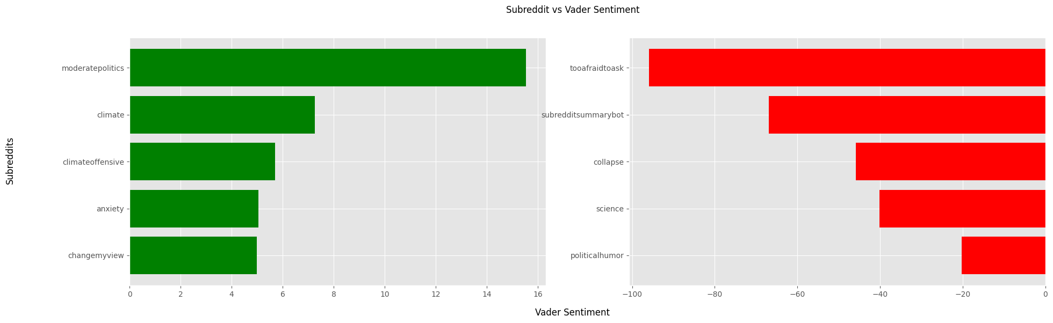
Reddit
Exploratory Analysis
9 August 2021: “tooafraidtoask”?

Slide 38
Reddit
Exploratory Analysis
9 August 2021: “tooafraidtoask”?
Comment_date | Comment | Score | Analysis
2021-08-09 | The newest report from the intergovernmental panel on climate change (IPCC) came out today and was kinda dire. I assume that’s why climate has been all over the front page today. World is going to die in 2050… | 1851 | IPCC AR6 2021
2021-08-09 | There have ALWAYS been doomsayers / preppers / end-of-the-world types. It's an evolutionary feature. We want some people to be taking all the precautions they can, so they survive the.... flood, plague, eruption, whatever. They're just wired that way. Climate change is a serious problem. We honestly don't know how bad it's going to get. There IS a chance that it's the end of human civilization. Biodiversity collapse, people back to the stone age. Bad stuff. Possibly. But the malthusians worried about over-population until we found out that developed nations stop having as many kids. And rail-road ties were going to deforest the planet until we found how to weather-treat them. And oil was going to run out until we found how to frack old wells and shitty tar-sand. In short, technology has the potential to save us. (Cause I highly doubt enough people will just put the brakes on burning so much and releasing CO2). A lot of people are working hard at this. There's money involved. They're working on carbon sequestration, cleaner power generation, sun shades… | 950 | Malthusians Malthus or to his theory that population tends to increase at a faster rate than its means of subsistence and that unless it is checked by moral restraint or by disease, famine, war, or other disaster widespread poverty and degradation inevitably result.
2021-08-09 | Due to overpopulation. Not climate change nonsense | -19 | Dismissive
2021-08-09 | It isn’t scientific to say that global warming will be catastrophic. It’s just not. Especially in the next 100 years. I understand one political party likes to scare people about climate change but the standard of living in 100 years will be way better than it is today Acting like we haven’t known that anthropomorphic climate change would be an issue is some serious right-wing copium. | -8 | Politics!
Notes:
Another interesting terminology here: Malthusians

Slide 39
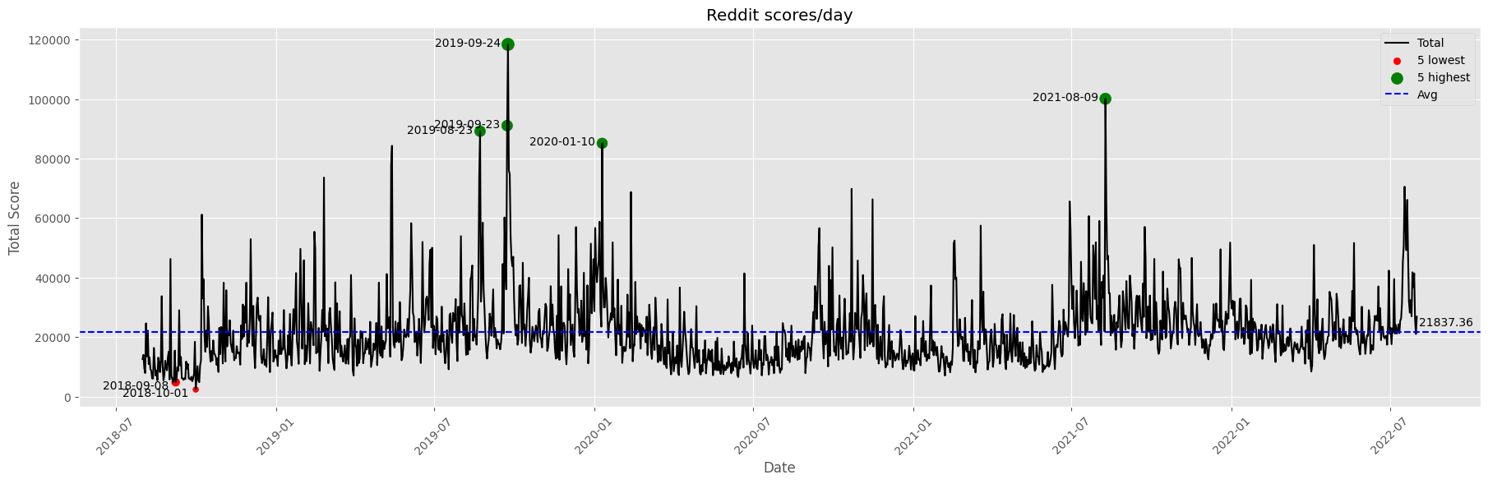
Reddit
Exploratory Analysis
Notes:
Scoring can only serve as a way to gauge response/reaction to others' sentiments., but cannot truly measure polarity of sentiment Eg. agreeing with someone expressing negative sentiment results in an upvote.
up/downvoting is a quick means for users to express agreement or disagreement without lengthy replies, but being binary in nature, it may not fully capture the complexity of opinions, lacking nuance
Highly subjective
When summing the scores, it becomes highly correlated with the volume of comments per day. Additionally, a highly upvoted comment can be offset by an even more downvoted one, misleading interpretations.
Therefore at a glance, days with more comments are expected to have higher scores. However, this correlation only holds to some extent, as new periods offer different patterns for analysis.
Generally, high total scores tend to be short-lived spikes, while lull periods are drawn out.

Slide 40
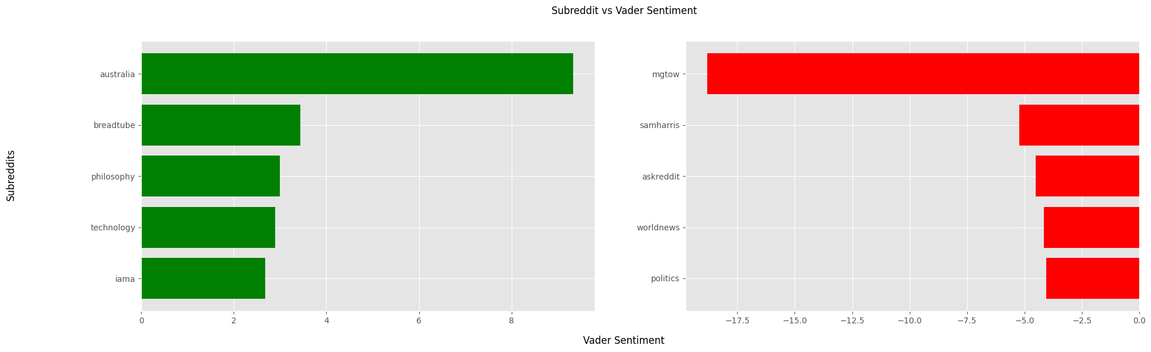
Reddit
Exploratory Analysis
8 September 2018:
really low volume, not much to analyze
“mgtow”: blatantly misogynistic hate group targeting women, has been banned since
“australia“
Notes:
…
For australia, I’m not sure why sentiments are positive, as you’ll see in the next slide

Slide 41
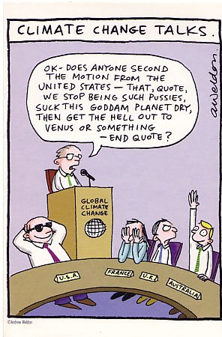
Reddit
Exploratory Analysis
8 September 2018: “australia”?
Comment_date | Comment | Score | Analysis
2018-09-08 | Believes in trickle down economics and the Easter bunny. Climate change is a bridge too far though. You’re a happy clapping ****, Morrison | 43 | “Australia’s National Energy Guarantee (NEG) is dead” Scott Morrison, Australia’s Prime Minister, after much internal party opposition NEG aimed to ensure energy security, reduce emissions, and provide investor certainty. Promised Australia still remains committed to meeting its Paris emissions targets - Yet, without the NEG, the national electricity market would “fall short of the emissions reduction target of 26% below 2005 levels”
2018-09-08 | Yup and they just kicked the latest one out because the word was he thought Climate change might be something we should look at. Not do anything about it but maybe have a look at it | 20 | Malthusians Malthus or to his theory that population tends to increase at a faster rate than its means of subsistence and that unless it is checked by moral restraint or by disease, famine, war, or other disaster widespread poverty and degradation inevitably result.
Notes:
This graphic means to criticize australia for blindly supporting USA even if the cause is blatantly wrong.

Slide 42
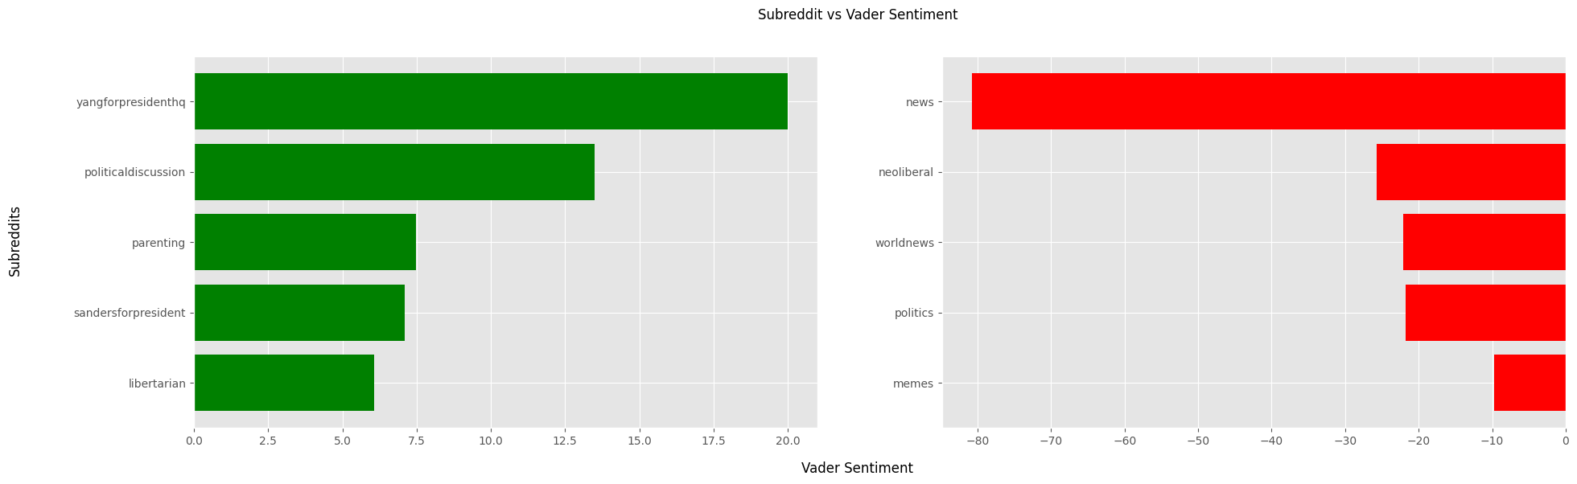
Reddit
Exploratory Analysis
23 August 2019:
Surprising, low volume but high score
What “news”?

Slide 43
Reddit
Exploratory Analysis
23 August 2019 : “news”
Comment_date | Comment | Score | Analysis
2019-08-23 | Who will fund climate change denial now? | 15444 | David Koch Billionaire, passed at age 79 Significant financial supporter of organizations and think tanks that have been skeptical or opposed to the scientific consensus on climate change and environmental, Eg. Americans for Prosperity, the Cato Institute
2019-08-23 | Most billionaires don't give a shit about climate change one way or the other. What makes (made) the Kochs so goddamn loathsome is that they went out of their way to be assholes when it didn't really benefit them all that much. Edit: It should be noted that they did benefit from being anti-environment, but to me, that's not their legacy… So much of the **** up, bizarro world political discourse we have in our country right now is a direct result of their specifically funding whackjobs who aren't just anti-environment, but anti-science, social conservative religious nutballs | 309 | Malthusians Malthus or to his theory that population tends to increase at a faster rate than its means of subsistence and that unless it is checked by moral restraint or by disease, famine, war, or other disaster widespread poverty and degradation inevitably result.
2019-08-23 | Did anybody actually read about him? supports women's right to choose supports gay rights supports same sex marriage supports stem-cell research against the war on drugs supported reducing government spending pro Wall-Street reform … And yes, he was a climate change skeptic. But in comparison to everything else...who cares. People are over-hyping that one issue to demonize him. | -19

Slide 44
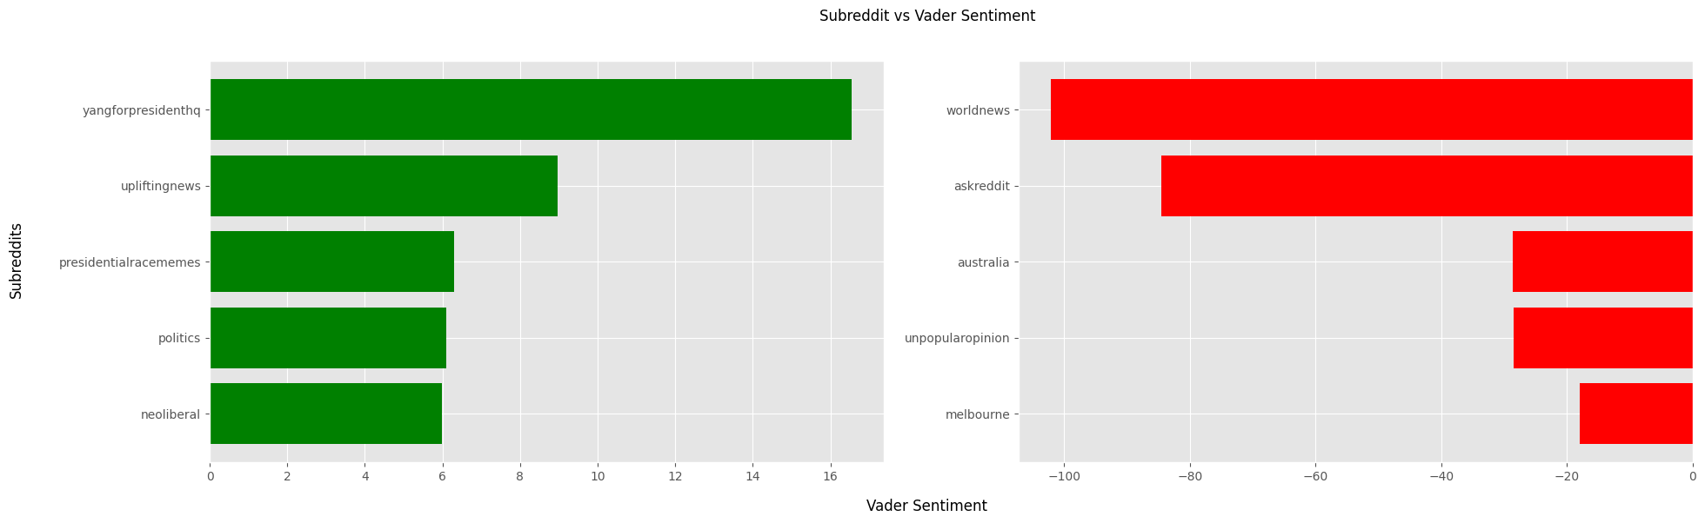
Reddit
Exploratory Analysis
10 January 2020: “worldnews”, “askreddit”

Slide 45
Reddit
Exploratory Analysis
10 January 2020: “worldnews”, “askreddit”
December 26, 2019 | Australia experiences devastating bushfires, causing widespread destruction and loss of wildlife.
Comment_date | Comment | Score | Analysis
2020-01-10 | I find this whole how the fire started debate pointless. How the fires started is not the issue, the real issue is the fact that the fires are bigger than ever, keep burning, cause huge amounts of destruction and are not showing any signs of slowing down. These factors are driven by climate change. | 269 | Australia Bushfires Might have been caused by human activity (arson) but exacerbated by ideal conditions like drought, strong winds News Corp’s coverage criticized for promoting misinformation downplaying climate change's role and instead emphasizing arson as a cause, diverting attention from the underlying crisis. Received international attention and aid
2020-01-10 | For one (very important and impactful) thing, (Australia government) cut funding to the fire services. Not to mention Morrison took a holiday to Hawaii while our country was burning. There are news clips of him visiting a few towns after returning, the local people hate him, they berate him to his face, refuse to shake his hand etc. | 371
2020-01-10 | Yesterday (Trump) made new rules to allow the government to ignore climate change in deciding on major projects And yesterday he finally admitted that climate change is "serious" and "nothing is a hoax" | 2223 | Malthusians Malthus or to his theory that population tends to increase at a faster rate than its means of subsistence and that unless it is checked by moral restraint or by disease, famine, war, or other disaster widespread poverty and degradation inevitably result.
2020-01-10 | "No, no. Not all all. Nothing's a hoax. ... It's a very serious subject. The environment is very important to me. I'm a big believer in that word, the environment ... I want clean air, I want clean water. I also want jobs, though.“ Translation: climate change is real, and very serious. I just like money more than a livable planet. | 4264

Slide 46
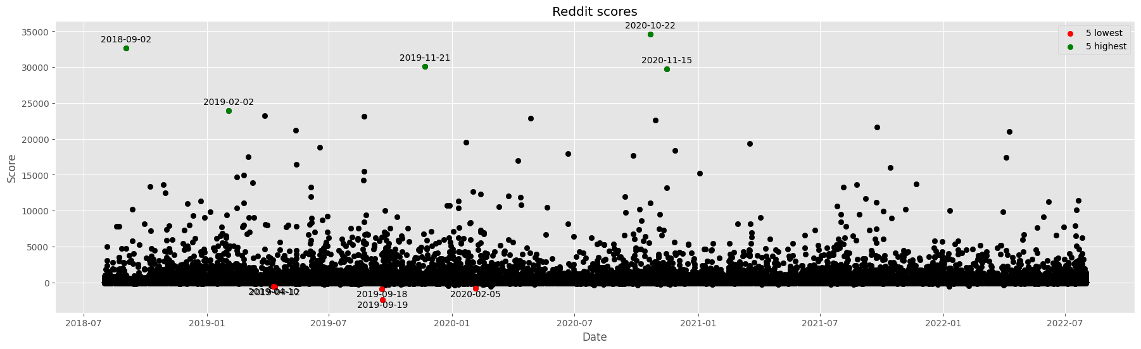
Reddit
Exploratory Analysis
Notes:
We observe that the majority of scores of comments fall very close to 0 to 5000.
Interestingly,
Top few positively outstanding comments didn’t all come from or close to the same period.
Our high volume and high scores period (20-28 September 2019) did not contain any of the top 5 comments. On the contrary, it contained 2 of the lowest-scored comments.
Volume and reception of comments dwindle from 2021 onwards
A comment all the way back in 2018 was the 2nd highest scored
What was the top comment for in this whole period?

Slide 47
Reddit
Exploratory Analysis
Comment_date | Comment | Score | Analysis
2019-09-19 | We should rewrite our immigration laws so that there is a safe, orderly and quick path to come to this country to work, to go to school, to join your family, to flee persecution or violence or disaster. We should never again criminally prosecute anyone seeking asylum or refuge; never separate another child from her family; never use immigration enforcement as a tool to breakup families or terrorize communities within the United States. We should work with the people of those countries - like El Salvador, Guatemala, Honduras — that are producing so many refugees to reduce violence, mitigate the effects of climate change and drought, and ensure that they have don’t have to make a 2,000+ mile journey to this country. We should legalize millions who are already here, starting with the more than 1m dreamers, make them u.s. citizens. And then, accomplishing all of this, we should expect that anyone coming to this country follows our laws and respects our borders. | -2379 | Robert Francis "Beto" O'Rourke U.S. representative for Texas, 2013 - 2019 Ran for presidential elections 2020 Held an “AMA” His comment poorly received and offended many
2019-09-18 | Do you people think climate change is just gonna explode the world in 10 years or something? Posts like this are always so dramatic. | -928 | Greta Thunberg The post was on Swedish Climate Activist Greta Thunberg rejecting the USA Senate Climate Change Task Force’s praises - “Don’t invite us here to tell us how inspiring we are without doing anything about it because it doesn’t lead to anything.”

Slide 48
Reddit
Exploratory Analysis
Comment_date | Comment | Score | Analysis
2018-09-02 | “Between Maryland doing this to honor their teammate and Texas showing both sportsmanship and support by declining the penalty, this is just amazing.” No, this is not amazing. **** this, and **** Maryland football. Throw that coaching staff in jail. Seriously. Maryland football built a culture of bullying and intimidating that put these kids at risk, and didn't pay them a cent while they make millions off of them. The coach forced the 19-year old into 110 yard wind sprints, despite, "showing signs of extreme exhaustion and difficulty standing upright.“ The kid collapsed from heat stroke and died in the hospital two weeks later… | 32654 | Exposing University of Maryland Death of19-year old Jordan McNair due to extreme fatigue after intense coaching Many instances of Violence and Intimidation Public abuse and humiliation Testimonials
2020-10-22 | January: Vaccine comes. It's free and has no side effects February: Movies that was supposed to be released 2020 all come out and the theaters are full of masterpieces March: Up and comming artists and authors have spent the lockdown sitting down to write and create. We're starting see the results of that. April: Lou Bega releases Mambo no. 6 and it is all people can think about this month. May: Turns out that climate change was a hoax. The climate just had a rough century and has learned to chill out more. June: An alien escapes Area 51. Turns out he is a nice dude and guests all the late night talk shows. On the inevitable Joe Rogan apparance they both do DMT and learn so much about each other. July: No one know why or how it happened, but suddenly money just isn't an issue anymore. August: The whole alien thing from June has started to affect how we view eachother on the planet. We are seeing a drastic and long lasting decline in terrorism and crime. September: God blessed us all October-November: Finally some normal and mundane events December: Home Alone remake with the original cast. All I want for christmas is eradicated. | 34619 | Predictions for 2021 Light-hearted, optimistic Given 2020’s events (Covid, elections)

Slide 49
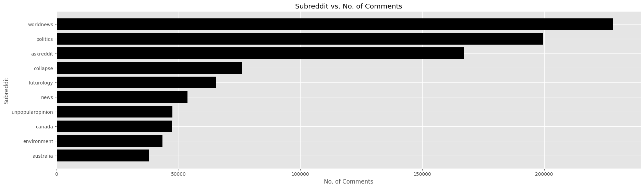
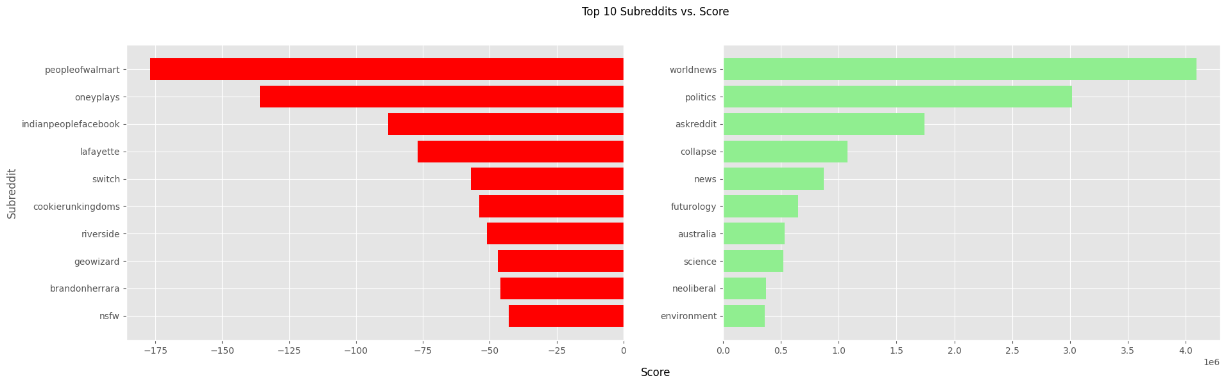
Reddit
Exploratory Analysis
Notes:
Here we can see some popular subreddits like politics, news, country-related subs like Canada, Australia, Lafayette which is a city in the state of Indiana in U.S and subreddit vs score: peopleofwalmart is an interesting one.
I won’t be able to go too in-depth in the interest of time but there are 2 subreddits I would like to highlight, howeve

Slide 50
Reddit
Exploratory Analysis
Zoom in on “oneyplays”, “cookierunkingdoms”, “lafayette"
Comment_date | Comment | Score | Analysis
2021-12-24 | nfts legit contribute to climate change so little, like less than 1%. companies like amazon and apple contribute to climate change so much more. instead of campaigning against devsis we should boycott amazon and other large companies | -66 | NFTs Cryptocurrency tokens representing digital ownership Does it contribute to climate change?
2022-06-24 | The majority in Indiana are conservative, and we adhere to conservative values. We're a red state, and we're proud of it. | -31 | Lafayette, Indiana Protest at the courthouse on 24 June 2022, against abortion
Notes:
When nfts was at its height, you could sell an nft of literally anything and people would buy it. Many people say it’s a scam, some say its not, etc
I’m not sure how that is related to climate change, but who knows? Maybe something to do with bringing children into the world when the world might end in 30 years? Shrug

Slide 51
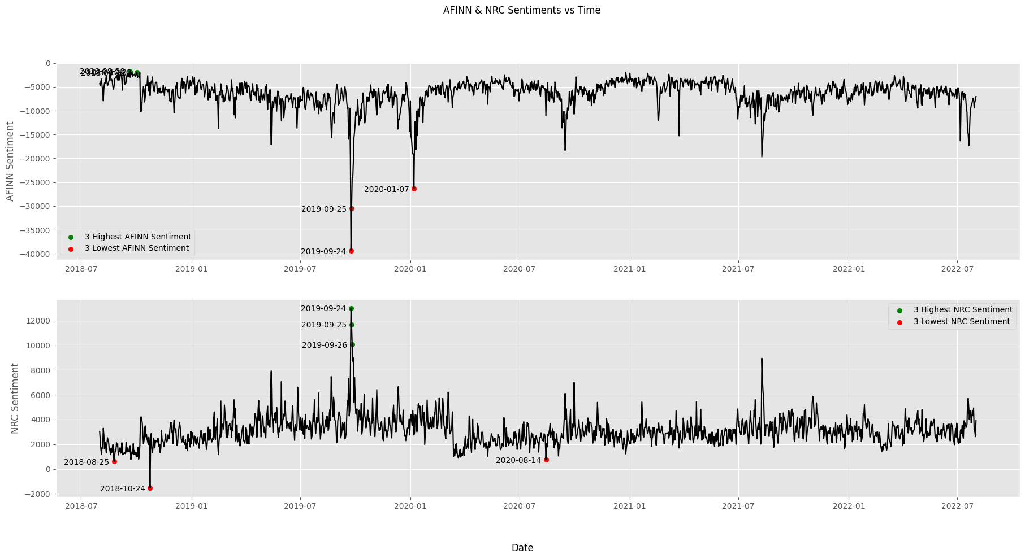
Reddit
Lexicon-based Sentiment (AFINN, NRC)
Notes:
There’s this nice graph I created, comparing AFINN & NRC Sentiments over time. They look like mirror images of each other, because if you guys recall in Week 3, just due to the lexicon and scoring system. But we can just look at the extremities and see they are quite similar generally. So AFINN would be the more correct or more intuitive representation here.

Slide 52
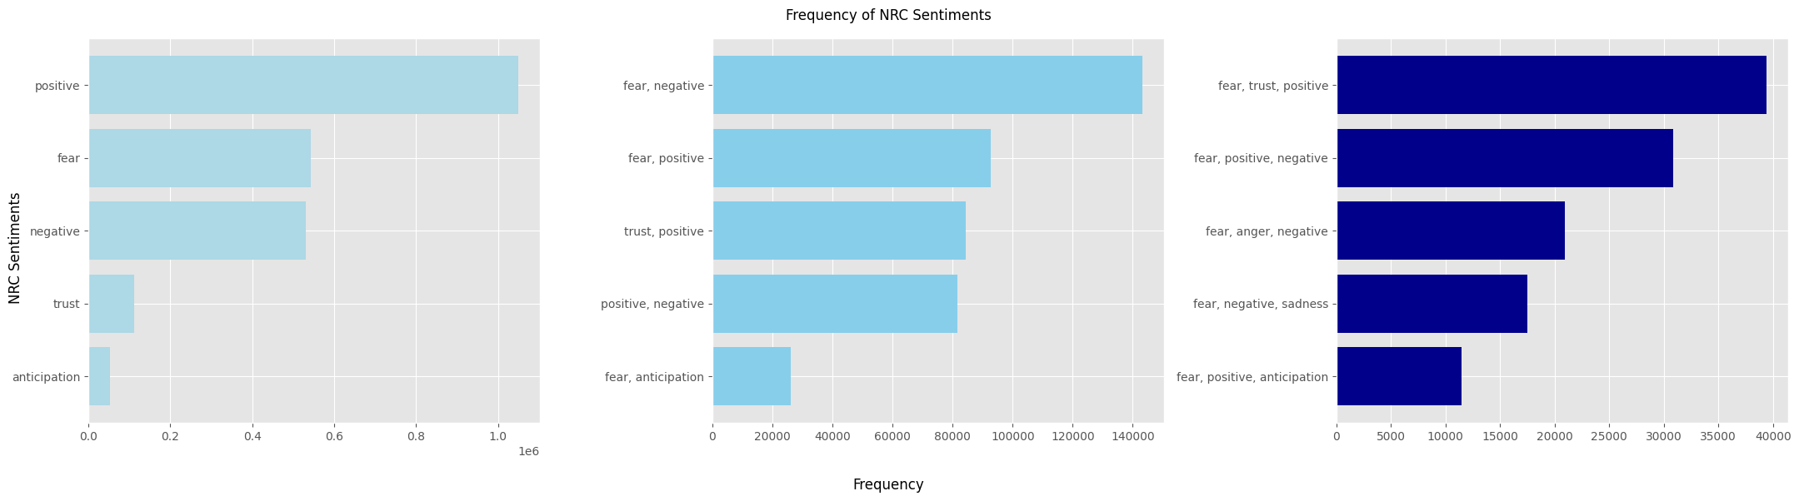
Reddit
Lexicon-based Sentiment (AFINN, NRC)
Generally more positive than negative
Fear and negative are tied, this is coherent with the 2nd plot
What is an example of positive fear?
Fear can come with anticipation
Fear, trust, positive?
Notes:
Something like n-grams, top associated sentiments
Describe the graph, what makes sense and what not

Slide 53
Reddit
Lexicon-based Sentiment (AFINN, NRC)
Fear, positive?
Fear, trust, positive?
Lexicon sentiment is not very accurate!
Comment_date | Comment | Score | Analysis
2022-04-02 | In relative terms, the greenback is still very strong. That said, war is occurring in Ukraine which is a massive grain exporter. Disease is still screwing up supply chains. Anthropogenic climate change is reducing global harvests. Interesting times. | 6 | Fear, Positive
2021-01-24 | We should destroy the oil and coal industry to move to a cleaner renewable energy. This will lose some jobs but will create many more better and safer jobs in the solar and wind industries. No one wants to invade the middle east for oil. | 3
2019-06-07 | They don't all "basically agree". Joe Biden wants a middle ground approach to climate change. | 19 | Fear, Trust, Positive
2019-09-14 | We'll probably still be trying to convince people that climate change is real while we get more and more natural disasters | 1
❌
Notes:
Keeping in mind that Lexicon sentiment is not very accurate to begin with
❌: Lexicon doesn’t recognize this is a negation of agree.

Slide 54
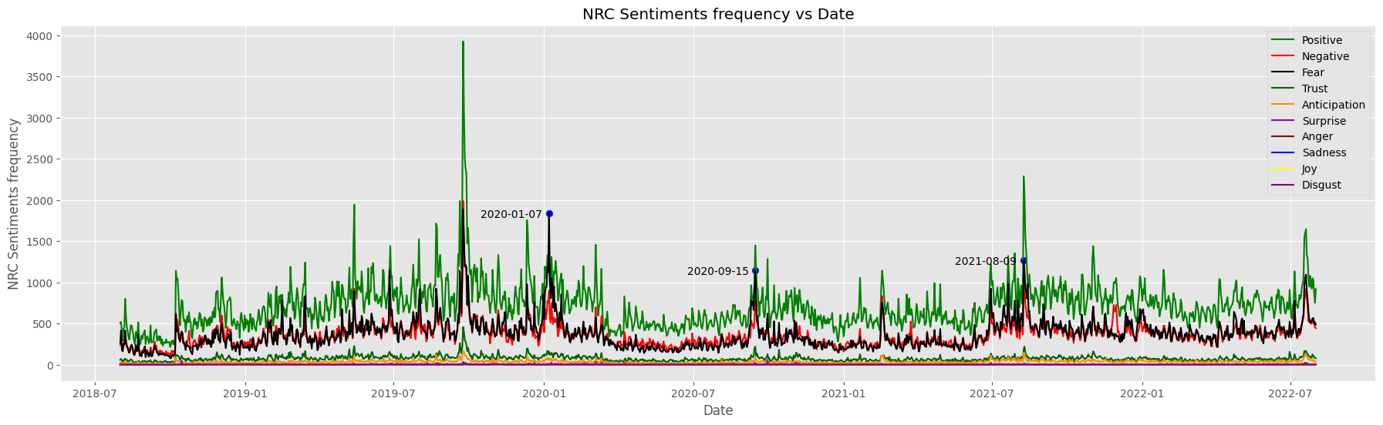
Reddit
Lexicon-based Sentiment (AFINN, NRC)
Major sentiments are positive, negative, fear in that order
Spikes/lulls in tandem
Fear traces negativity, but higher in 2 major periods
Notes:
This complements the previous graph, the legend is ordered from highest to lowest frequency. This is plotted against time though so we can do some temporal analysis like spikes/lulls ….

Slide 55
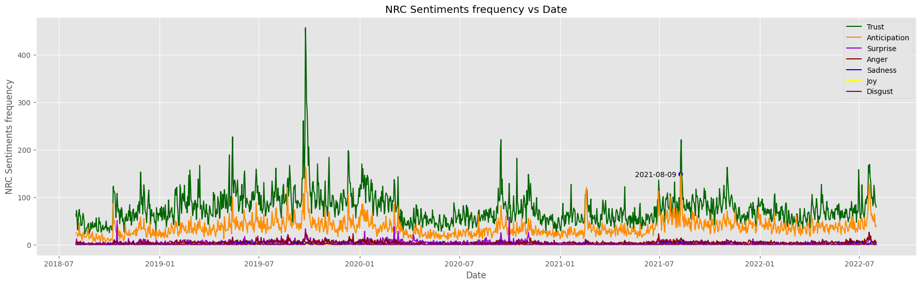
Reddit
Lexicon-based Sentiment (AFINN, NRC)
Zoom in on the rest
Notes:
This complements the previous graph, but it is plotted against time so we can do some temporal analysis like spikes/lulls ….

Slide 56
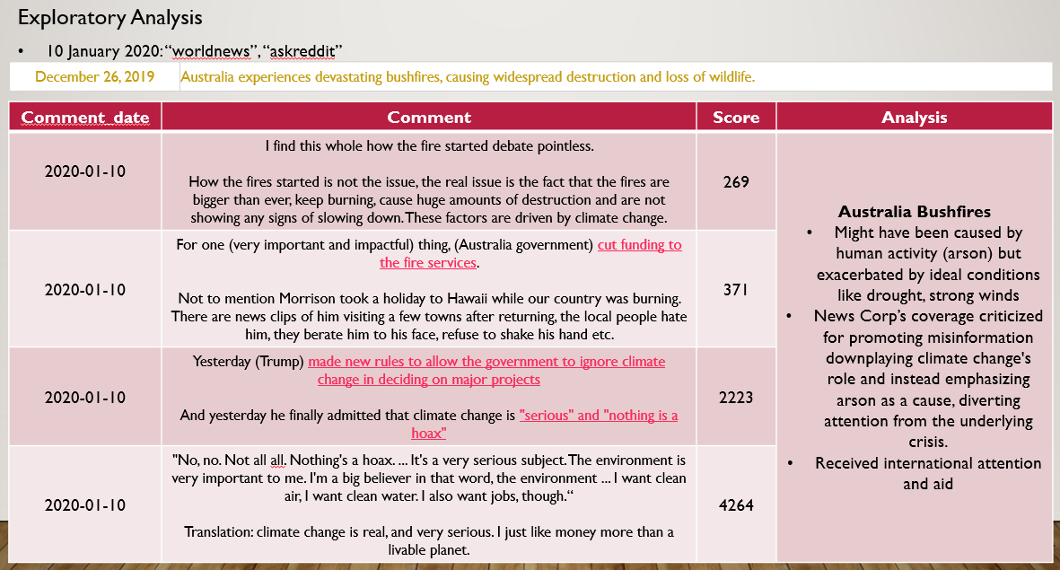
Reddit
Lexicon-based Sentiment (AFINN, NRC)
7 January 2020:

Slide 57
Reddit
Lexicon-based Sentiment (AFINN, NRC)
7 January 2020:
Mostly Australian bushfires (animals, arson, climate change conditions, fossil fuel companies, government, media)
Rory Norman’s death after shooting in South Dallas on 5 January
Stampede killing several mourners at the burial of Iraq’s military commander, which Trump ordered a drone strike on.
Notes:
Bushfires that killed a lot of animals | discuss how it was caused by arson, climate change conditions, fossil fuel companies | but due to government inefficacies at addressing the problem | media exacerbating it by running misinformation campaigns
…
…
Some of these are not immediately related to climate change, but climate change is political in nature and some of these issues are also related to politics as you can see. So “climate change” appeared in some of the comments to be included in this dataset. So this fear isn’t only isolated to climate change

Slide 58
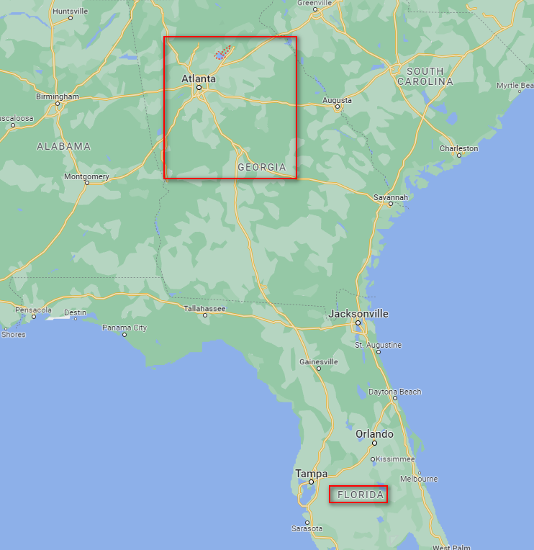
Reddit
Lexicon-based Sentiment (AFINN, NRC)
7 January 2020:
3-Decade-Long Georgia-Florida Water Dispute Heads To Supreme Court
Due to climate warming => droughts
Not enough water flowing downstream for Florida, saying Georgia isn’t doing enough to cap its water usage
Georgia says it’s already doing a lot, more so than other states
“water that starts at Lake Lanier, a reservoir northeast of Atlanta. It generates hydropower as its water is released from a dam into the Chattahoochee River.”.
Notes:
…
They’re so far, not really sure how water systems work

Slide 59
Reddit
Lexicon-based Sentiment (AFINN, NRC)
15 September 2020:
West Coast (California) wildfires
Record breaking, burnt through 2 million acres
Hundreds of marijuana businesses threatened
If not completely razed, need to decontaminate
“climate injustice”
Notes:
…
Decontamination is via a process called bud-washing, which still wouldn’t be sufficient, so small, family businesses would be hit the hardest which results in climate injustice

Slide 60
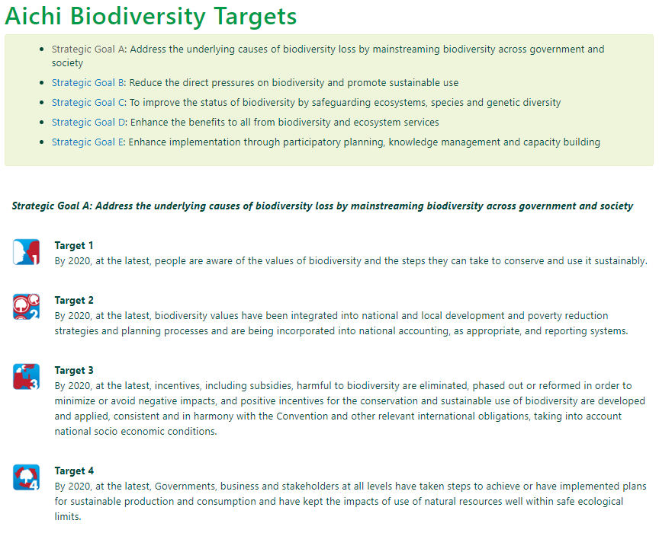
Reddit
Lexicon-based Sentiment (AFINN, NRC)
15 September 2020:
UN reports: “World fails to meet a single target to stop destruction of nature”
Aichi Targets, adopted during the U.N. Convention on Biological Diversity (CBD) summit in 2010
20 targets broken down into 60 separate elements to monitor overall progress. 7 elements achieved, 38 have shown progress,13 have shown no progress, 2 unknown progress

Slide 61
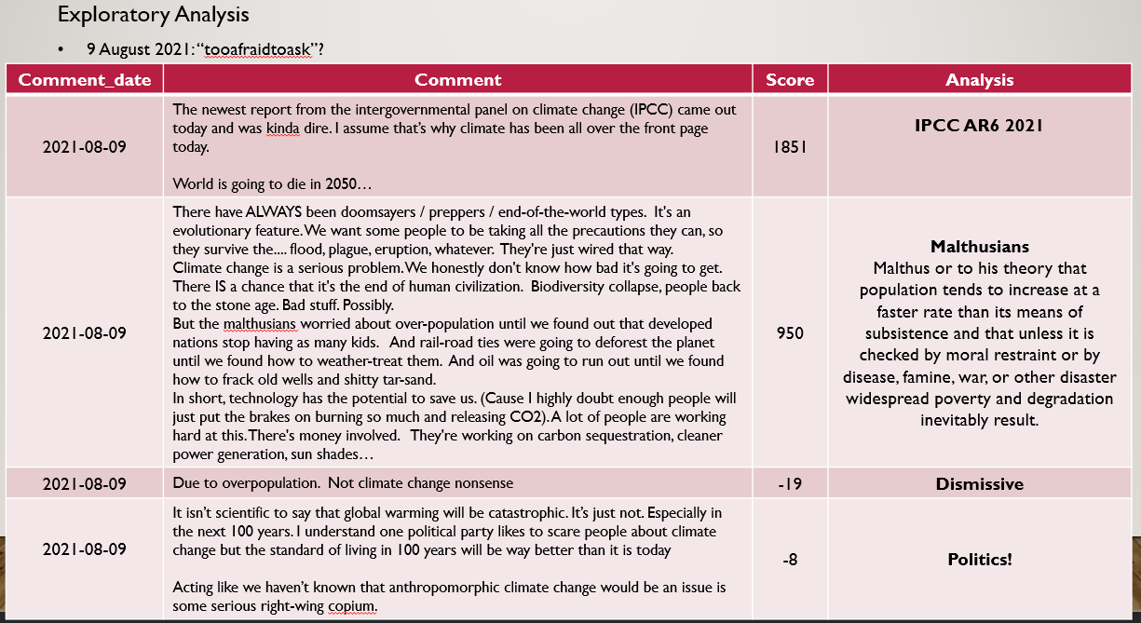
Reddit
Lexicon-based Sentiment (AFINN, NRC)
9 August 2021:
Notes:
Fear and Anticipation, we’ve covered it

Slide 62
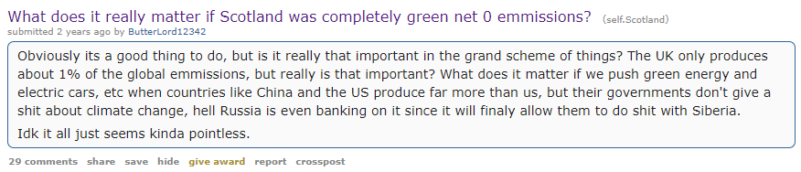
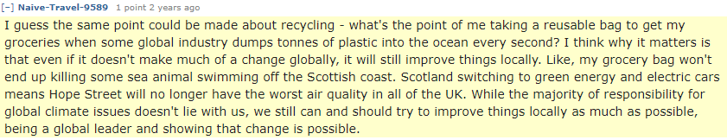
Reddit
Lexicon-based Sentiment (AFINN, NRC)
9 August 2021:
Notes:
Following this, I would like to highlight this post and a reply to it that I find quite wholesome

Slide 63
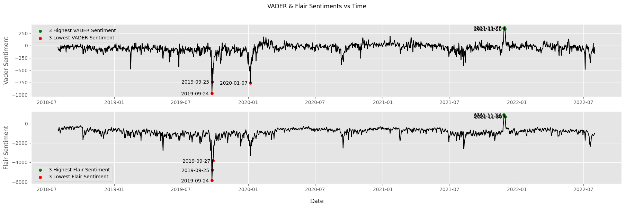
Reddit
Sentence-based Sentiment (VADER + Flair)
What’s going on around 27-30 November 2021?
Notes:
Interesting that our lexicons didn’t pick out this peculiarity

Slide 64
Reddit
Sentence-based Sentiment (VADER + Flair)
27-30 November 2021:
Comment_date | Comment | Score | Analysis
2021-11-28 | I'm 25, either one of the youngest millennials or one of the oldest zoomers Nearly every younger person I talk to is into fighting climate change, fixing work in America, and is inclusive to LGBTQ+ people …"Strong men make good times. Good times make weak men. Weak men make hard times. Hard times make strong men.“ We're at the "Hard times make strong people" stage, and millennials and zoomers are coming into power enough to start making good times It will suck because of climate change and resource depletion, but we'll do it. Strong people have tackled huge and apocalyptic conditions before, and we have such powerful tools at our disposal Millennials were the speartip, zoomers are the full blade, let's go! | 79 | Population Positive side of raising children despite climate
2021-11-27 | …a sibling may help that child in the future. They will have each other. I’m kind of playing devils advocate to my own intuition, which is that no more children should be brought into this dying world. (but) I am glad they have each other. My sibling says the first baby will be strengthened by their own sibling, just as we have always strengthened and supported each other. And I can’t disagree with that, really. If you have another, raise them to be friends and to know the meaning of support and love for each other. They may really need each other in this screwed up future we are going into. | 26
2021-11-30 | “…I extend my congratulations to you and all Barbadians," the Queen wrote. "Over the years, our countries have enjoyed a partnership based on common values, shared prosperity, and close collaboration on a wide range of issues, including recent work on climate change. It is also a source of great satisfaction that Barbados remains an active participant within the Commonwealth, and I look forward to the continuation of the friendship between our two countries and peoples." | 131 | Barbados removes Queen Elizabeth as Head of State, to become a Republic
Notes:
Seems to be nothing much, I guess there were no horrible events in this period either,

Slide 65
Reddit
Perspective API
Perspective is a free Google API that uses machine learning to identify “toxic" comments, making it easier to host better conversations online
Perspectives | IDENTITY_ATTACK | INSULT | PROFANITY | SEVERE_TOXICITY | SEXUALLY_EXPLICIT | THREAT | TOXICITY
FLIRTATION | IDENTITY_ATTACK | INSULT | PROFANITY | SEVERE_TOXICITY | SEXUALLY_EXPLICIT | THREAT | TOXICITY
Notes:
This API offers a few attributes, and I think it’d be interesting to see the different vectors of attacks people can create on climate change, and how much of it actually doesn’t relate to climate change itself, and just attacking the individual itself.

Slide 66
Reddit
Perspective API
Identity attack
Comment_date | Comment | Score | Analysis
2018-11-11 | Blech you're an idiot. Why do you believe anything climate scientists say? They have never created an accurate model predicting future climate. ... 2 random doctorates need to critique your work in order for it to pass (they are probably kikes but you have no idea who they are) as a result the whole thing becomes a game if who can ingratiate themselves to their reviewers by building upon their work. Dissent is impossible, there is no empiricism everything is based off of theoretical models that are manipulated through all kinds of statistical tricks. Further there is too much money in AGW to allow any dissent. The coordination between academia the media and government is too large in scope to have anyone question the results. Ultimately AGW is an excuse for the government to gain more control over your life. The amount of CO2 in the atmosphere doesn't matter because there are no positive feedback back loops in nature. Here's a thought as the sun approaches supernova maybe climate patterns are different from those of a century ago. Stay dumb **** | -1 | Anthropogenic Global Warming (AGW) increase in the Earth's average temperature is primarily caused by human activities driven by financial and political motivations
Notes:
Alright let’s continue.
So we will skip a few of them like flirtation & sexually_explicit for obvious reasons
Starting off with Identity Attacks

Slide 67
Reddit
Perspective API
Identity attack
Comment_date | Comment | Score | Analysis
2019-03-07 | Your barbecue emits more than a car, a fire emits more than a car. Your cooking emits more than a car. You have extractor fans getting rid of the thick smoke from food and its fats these are bad for lungs. Where does the fan blow that air? And it doesn't remove all the emissions. Like smoking. Your building emits more than a car from your heating. Every time they renovate a building, or it has a fire or disaster, or they make a building, lay a road, it causes pollution. Many of the materials have harmful dust. Carbons are released in every single thing we do. Everything… Electric cars are a hoax. They break even quicker. Electrics don't work in the weather. they break real quick because they use more electricity. Like your shitty phone needing an upgrade tomorrow. It doesn't get a signal in weather it switches off and overheats quicker. Just like your shitty computer out of date on the day of purchase. This medium drives up consumption. Causing a huge demand. Forcing debt. Change to infrastructure causes increased costs. All so they can target you with advertising. Where they, these people are evil, real evil, can control every aspect of your existence. You have no more freedom and now your car is redundant. As you become a slave to being fully monitored and all they sell you is dystopia. | 0 | Skepticism Emissions and pollutants are generated by everyday activities like cooking, heating, and building renovations Electric car not effective as they break down quickly and are not suitable for adverse weather conditions Increased consumption, debt, and loss of personal freedom due to changing technologies and infrastructure

Slide 68
Reddit
Perspective API
Insult
Comment_date | Comment | Score | Analysis
2019-02-27 | Do you believe in Climate Change? What is causing it? If humans are causing it the only way to beat it, is to lessen the human population. No solution they come up with will sustain a gaining population causing change. But that isn't the complete cause of climate change. Because this planet has ice-ages anyway. Now if our true north has moved. What effect does it cause? Displacement obviously. Where activity extreme weather, sooner increases regardless of dumb humans gaining and heightening their own disaster. Yes, they cause pollution and destroy ecosystems causing species to go extinct, but not entirely. And stupid google electricity doesn't do shit. It's actually quite stupid. If we are experiencing extreme weather why are we changing to systems indebted to the weather? But these systems are even worse than that. They are designed to upgrade, using electricity in constant service and repair, breaking sooner like your stupid iPhone it lasts 2-3 years, causing increased consumption and demand, but they simply aren't a viable solution to increasing populations with millions upon millions consuming even more electricity. Although any hiccup in the increasing weather a geomagnetic/electromagnetic phenomenon they are obsolete those grids go down sooner they do almost every storm. | 1 | Reducing population might be the only solution to mitigate its effects climate change is a natural phenomenon influenced by factors like ice ages and shifts in the planet's true north electricity-based systems vulnerable to disruptions caused by geomagnetic and electromagnetic events, reducing stability
Notes:
Insult

Slide 69
Reddit
Perspective API
Profanity
Comment_date | Comment | Score | Analysis
 | Just a lot of f***s
Notes:
Profanity

Slide 70
Reddit
Perspective API
Threat
Comment_date | Comment | Score | Analysis
2019-10-23 | I swear I’m gonna be the next hitler but I’m just gonna kill the **** idiots and nobody will even try to stop me. Flat earthers? Get launched into space to see how the world really is a **** globe. Antivaxxers? Ima sneeze on them and they’ll die. Climate change deniers? Gonna burn them and see how they like it. Chem trail believers? Gonna throw them out of a 747 and ask them how the air tastes. People that think the moon landing was faked? Well they can stay cause there’s some actual reasoning behind the arguments but they can only live in work camps. … And then with the money they had budgeted for tinfoil hats and essential oils that we’ll take of them, we can provide vaccinations to those in 3rd world countries where it’s needed… | 4
Notes:
Threat

Slide 71
Reddit
Perspective API
Toxicity & Severe toxicity
Comment_date | Comment | Score | Analysis
2020-03-13 | …Seriously any so called "scientist" who doesn't understand the severity of the threat of climate change is not a **** scientist, they are a joke… | 1
2021-10-09 | UN can ****. They are saying this so they can take the moral high ground in 10 years, "oh but we declared it a human right, look how hard we fought for climate change". In reality they did **** all, for decades even colluding with industry and companies to maintain the status quo. | 17
Notes:
Toxicity & Severe toxicity

Slide 72
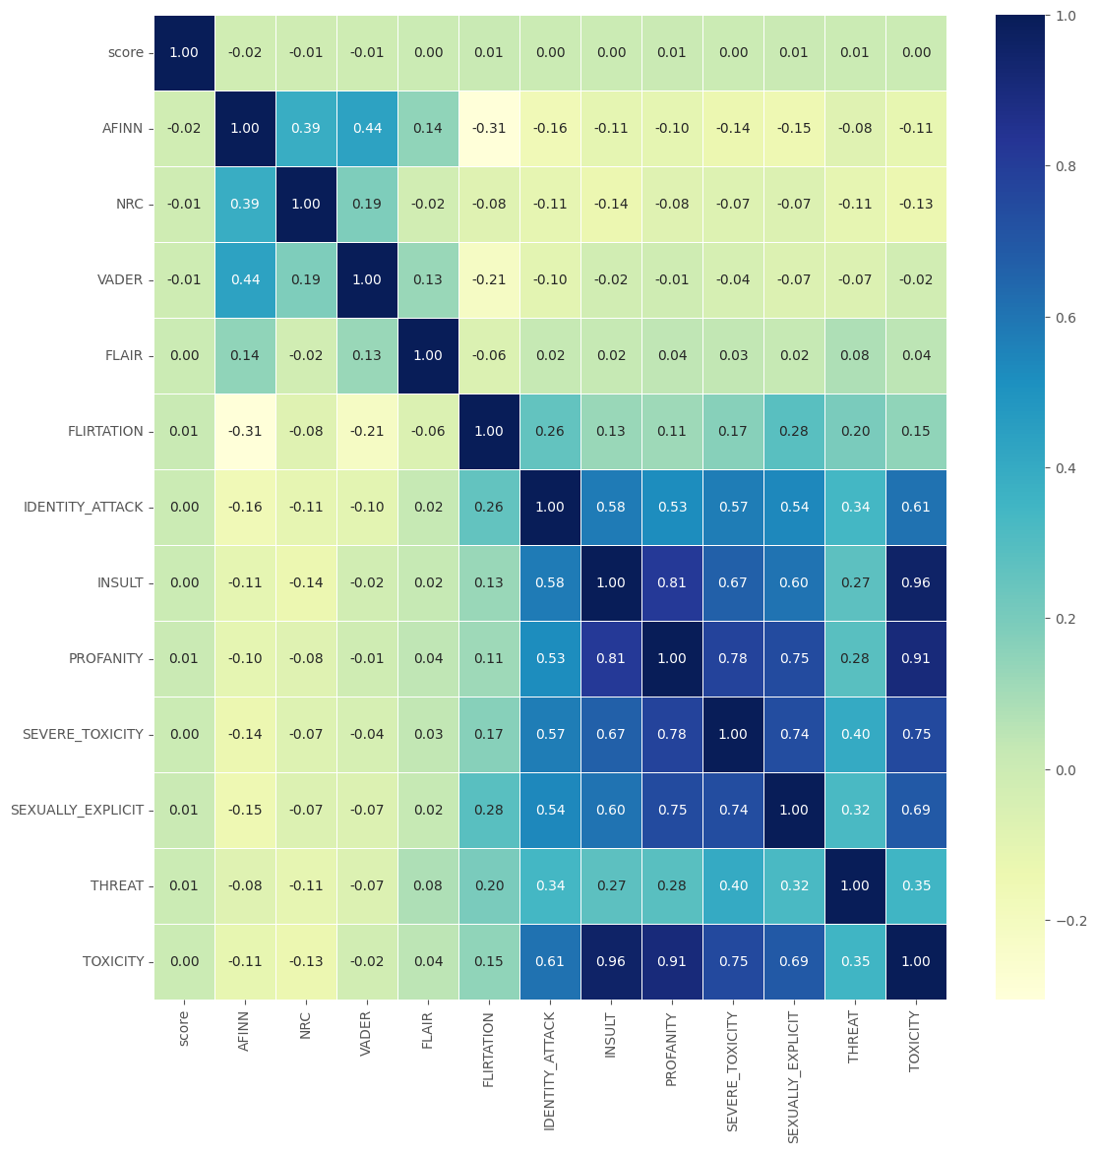
Reddit
Correlation Heatmap
Notes:
The darker the cells are, the higher the correlation and yeah, it makes sense
We see that there is actually little to no correlation
b/w score & sentiment, as sentiment can be negative (eg. Anger, disappointment, sadness) and still gain a high score just due to how many people resonate with that in that time
between the models, perhaps due to different scoring systems.
However, as expected, there is some with regards to the perspectives.

Slide 73
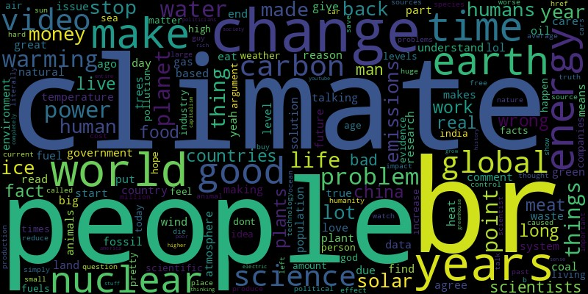
Youtube
Exploratory Analysis
Notes:
Nothing in particular, there’s emphasis on nuclear and solar

Slide 74
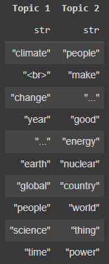
Yotube
Topic Modelling
Notes:
Topic 1 could be Environmental science? More general
Topic 2 could be Sustainable energy? More specific, tells us "nuclear energy" is commonly associated with "good"

Slide 75
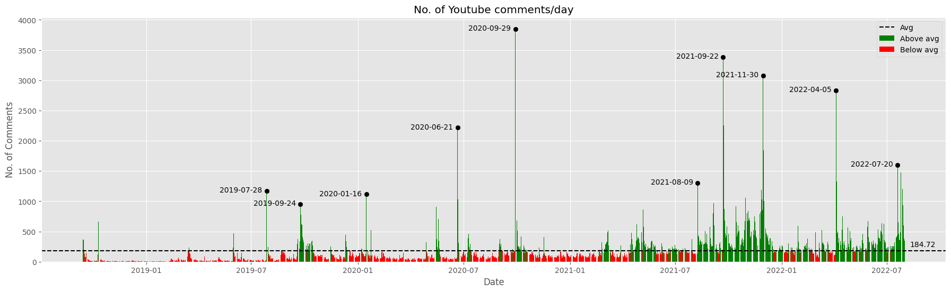
Youtube
Exploratory Analysis
Generally, there are fewer comments on Youtube as
Videos to post comments on
Video content is harder & more time-consuming to create than text.
⬆️quality, ⬆️engagement, ⬆️comments
Some differences
Shorter comments, as primary engagement is with video over comments
More expression with emojis

Slide 76
Youtube
Exploratory Analysis
Why always September???

Slide 77
Youtube
Exploratory Analysis
28 July 2019:
Climate Change Activists vs Skeptics: Can They See Eye To Eye? | Middle Ground (Jubilee)
All Americans
Activists: younger, Skeptics: older
Comment_date | Comment | Likes | Analysis
2019-07-28 | “It’s my right to destroy the environment.” That’s basically it | 7164 | People making fun of the skeptic comments Disapproval
2019-07-28 | They couldn’t water their lawn?? And thats suppression?!? Try losing your home because sea levels have rose | 5326
2019-07-28 | Karen: “I know thousands of scientists that say otherwise” Don (AN ACTUAL CLIMATE SCIENTIST): “Am I a joke to you??” | 7000
Notes:
In this video, as the title suggests, it was a discussion on whether climate change was real. The people were all Americans
The row highlighted green is the most liked comment
If you haven’t seen Jubilee’s videos, I’d recommend them, they do and talk about really fun and interesting stuff :)

Slide 78
Youtube
Exploratory Analysis
24 September 2019: Greta Thunberg (TED, Guardian News, VICE News)
16 January 2020: Fortnite climate change challenge (Lazarbeam)
Notes:
I’ll briefly touch on some of the others if they have either been discussed before or are not very relevant, so we can have a more holistic view
Was …
Dominated by a fortnite…

Slide 79
Youtube
Exploratory Analysis
21 June 2020:
Who Is Responsible For Climate Change? – Who Needs To Fix It? (Kurzgesagt – In a Nutshell)
“Who is responsible”? “Everyone”
Comment_date | Comment | Likes | Analysis
2020-06-21 | In the Paris Accords, “each country sets their own goals” Which is completely pointless, what’s to stop China from setting a goal of recycling 1 piece of paper while Canada sets a goal to recycle 100 million tons of paper. That’s why Trump pulled out of the Paris Accords. | 0 | U.S leaving Paris Climate Agreement Voluntary targets, no penalty due to sovereignty
Notes:
kurts·guh·zaakt

Slide 80
Youtube
Exploratory Analysis
21 June 2020:
Who Is Responsible For Climate Change? – Who Needs To Fix It? (Kurzgesagt – In a Nutshell)
Comment_date | Comment | Likes | Analysis
2020-06-21 | Nuclear is less expensive compared to a large amount of solar and wind as those don’t produce as much energy and are unreliable. Hydro can only be placed where there is water while it’s renewable and produces a lot of power, Green and reliable you can’t usually power most of your country with hydro unless I you have a lot of waterways you do that by having a lot of land or just being by a bunch or having the biggest waterfall in your borders Nuclear is much more cheap if you look at the math because Green Solar and wind don’t produce enough so you have to build a lot of them while nuclear as long as you can fit it if you have a small country maybe 1 or 2 nuclear plants are necessary if you live in a country like the U.S maybe 183 are necessary and nuclear waste can be reused and somewhere in Finland they are making permanent storage for nuclear waste the only problem is to make a warning sign that will out live us | 0 | Nuclear Energy Pros Comparatively cheaper than generating a large amount of energy from solar and wind sources, which are less reliable. Cost-effective due to its efficient energy production, making it a viable option for smaller countries with limited space or larger countries needing multiple plants. Reusable, and efforts are being made to create permanent storage solutions in places like Finland A challenge in nuclear waste management is creating a warning system that will remain effective for a long time. Hydroelectric power is renewable and efficient, but depends on the presence of waterways and water sources, making it challenging for widespread use.

Slide 81
Youtube
Exploratory Analysis
29 September 2020:
Donald Trump and Joe Biden on California wildfires, climate change policies (CNBC Television)
Can We Terraform the Sahara to Stop Climate Change? (Real Engineering)
Comment_date | Comment | Likes | Analysis
2020-09-30 | “It’s a great project called the BILLion tree project, we’re planting a BILLion trees.” Okay ya that’s going to help all my friends and family members whose homes have burned down, planting more trees that aren’t going to be maintained... | 46 | Skeptical about effectiveness Mocking the purpose of actually planting trees
2020-09-30 | "we have trees, beautiful trees, we want clean air, everyone agrees with us, we plant many trees" - Trump's policy to fight climate change | 153

Slide 82
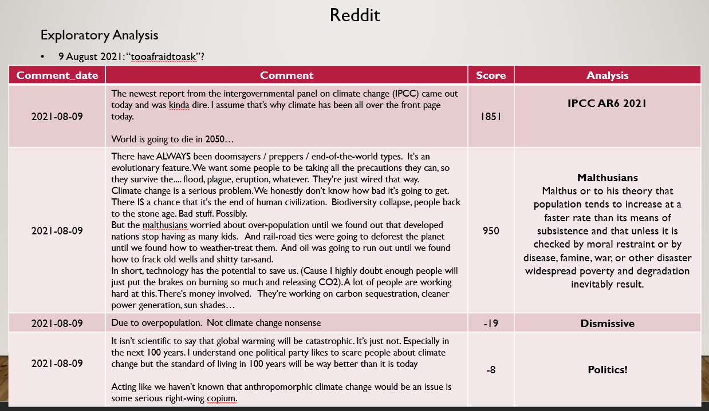
Youtube
Exploratory Analysis
22-23 September 2021:

Slide 83
Youtube
Exploratory Analysis
22-23 September 2021:
Notes:
Maybe this inspired a whole load of videos within a period, as you can see it’s mostly green +-2 months

Slide 84
Youtube
Exploratory Analysis
22-23 September 2021:
Can YOU Fix Climate Change? (Kurzgesagt – In a Nutshell)
Fast Fashion Is Hot Garbage (Climate Town)
Robert Kennedy Jr. on 'Controversial' Vaccines, Trump, and climate change (Yahoo Finance)
Comment_date | Comment | Likes | Analysis
2021-09-22 | "we need politicians to..." There's the problem. | 6323
2021-09-22 | We need a climate aware dictator. Note that a dictator per se is not necessarily a bad thing. A dictator in the classic (roman) sense is a person who has, for a limited amount of time, the power and authority to force ppl to act in a certain way, to deal with a given crisis, and when the crisis is over, the dictator usually stepped down and was a common citizen again. … it's really just a person who temporarily has the authority to deal with a crisis, if necessary against the wishes of their people. …Discussions are overloaded with ignorance, ideology, stupidity and stubbornness, and nothing really gets done. We have wasted decades already not dealing with it. Green parties are on the rise, yes, but it's way too slow to effectively turn things around or at least slow the CC processes down. Sadly. Climate aware dictators are exactly what can help here, under the condition that they are free from ideology and lobbyism. Hard scientific facts are all that should guide them. But currently I don't see anyone willing and capable to fill that role. | 0 | “Climate Change Dictator” Advocates for a leader guided by hard scientific facts, free from ideology or lobbying influences Current discussions on climate change are hindered by ignorance and ideology

Slide 85
Youtube
Exploratory Analysis
30 November 2021:
Is Meat Really that Bad? (Kurzgesagt – In a Nutshell)
Global Warming: Fact or Fiction? Featuring Physicists Willie Soon and Elliott D. Bloom (Independent Institute)
Climate change – living on the water (DW Documentary)
Rethinking Climate Change. The path to a 90% emissions reduction by 2035 (Just Have a Think)
What Will Happen if Earth's Temperature is Raised 2°C (SciShow)
Why you don’t hear about the ozone layer anymore (Vox) Arnold Schwarzenegger calls leaders 'liars' over climate change (BBC News)
Comment_date | Comment | Likes | Analysis
2021-11-30 | For all those asking why they didn't cover artificially produced meat - it's because it doesn't exist on a commercial scale yet. Nobody has managed to scale artificial meat production (as opposed to meat substitutes) to a scale where it's capable of being part of the solution. If it turns out to be possible to produce artificial meat cheaply en-masse then that would be great, but you can't rely on a technology that nobody has yet proved works (and is economically viable) on a large scale, and nobody is capable of predicting whether technology that doesn't currently exist might exist in the future. It's the same reason why nobody is going to suggest humanity will depend on nuclear fusion in a video on future energy - it'd be great if it became feasible, but nobody knows whether it ever will. | 2261 | Artificial meat production isn't on a large scale yet. Meat substitutes are different from true artificial meat. Relying on unproven technology is not advisable. Just like nuclear fusion for future energy, feasibility is uncertain.

Slide 86
Youtube
Exploratory Analysis
30 November 2021:
Is Meat Really that Bad? (Kurzgesagt – In a Nutshell)
Global Warming: Fact or Fiction? Featuring Physicists Willie Soon and Elliott D. Bloom (Independent Institute)
Climate change – living on the water (DW Documentary)
Rethinking Climate Change. The path to a 90% emissions reduction by 2035 (Just Have a Think)
What Will Happen if Earth's Temperature is Raised 2°C (SciShow)
Why you don’t hear about the ozone layer anymore (Vox) Arnold Schwarzenegger calls leaders 'liars' over climate change (BBC News)
Comment_date | Comment | Likes | Analysis
2021-12-01 | Here is a quote from Our World in Data. "Beef stands out immediately. The expansion of pasture land to raise cattle was responsible for 41% of tropical deforestation. That’s 2.1 million hectares every year – about half the size of the Netherlands. Most of this converted land came from Brazil; its expansion of beef production accounts for one-quarter (24%) of tropical deforestation. This also means that most (72%) deforestation in Brazil is driven by cattle ranching. Cattle in other parts of Latin America – such as Argentina and Paraguay – also accounted for a large amount of deforestation – 11% of the total. Most deforestation for beef therefore occurs in Latin America, with another 4% happening in Africa." | 0
2021-12-01 | Something of huge, massive importance is missing when agroecology (which includes agroforestry, and especially silvopastoral systems in the matter of meat) is totally left out. It is sad to see that people still don’t know it is possible to grow crops without fertilizers and pesticides, or grow cattle without tearing down rainforests. Even more, it is sad not to be able to watch compared data between agroecology and conventional agriculture and cattle raising. And that’s not even including the enormous cultural baggage that agroecology approaches bring into the countryside and the communities living there. | 54 | Agroecology Focuses on creating harmony between farming practices and the natural environment, enabling crop and cattle production without harm Subsets of, which are agroforestry and silvopastoral systems, are missing

Slide 87
Youtube
Exploratory Analysis
5 April 2022:
We WILL Fix Climate Change! (Kurzgesagt – In a Nutshell)
“We’re at the point where not decarbonising is a bad business decision”
English Vocabulary: CLIMATE CHANGE (Learn English with Gil)
Comment_date | Comment | Likes | Analysis
2022-04-05 | France has alot of Problems with their energy stability BECAUSE their nuclear plants are old. Several are offline for Inspections/Repairs. In Summer, some Nuclear plants have to be shut down, because of Lack of Cooling Water (they get their Water from nearby Rivers). Summer > hot > many active AC units > more energy consumptions > low Water in Rivers > Reactors cant be cooled properly > Energy problem. The Ukraine-Invasion is a good Point. Russia took over the Tschernobyl Ruins and other Nuclear plants. They didnt had trained Experts with them and they interrupted the Shift-Change for the Workers. Both could have lead to Catastrophes. Another Risk is Terrorism. Conventional Plants are meant to keep the Process running. A Nuclear plant is meant to stop the Process from running wild. so its the opposite Setting. If a Conventional Plant gets damaged, you get a Blackout. If a nuclear plant gets damaged, you get a Blackout AND a catastrophe. | 0 | France’s energy stability issues Due to old nuclear plants that are frequently offline for inspections and repairs. During summer, some nuclear plants must be shut down due to a lack of cooling water from nearby rivers. High summer temperatures lead to increased energy consumption from air conditioning units, causing low river water levels that hinder reactor cooling. Ukraine invasion Russia took control of Chernobyl and other nuclear plants without trained experts and disrupted worker shifts, posing catastrophe risks. Terrorism poses a significant risk to nuclear plants as their design focuses on controlled shutdown, making them vulnerable to sabotage. Conventional plants result in blackouts when damaged, while nuclear plant damage can lead to both blackouts and catastrophic events.
Notes:
More recent times

Slide 88
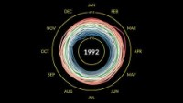
Youtube
Exploratory Analysis
5 April 2022:
Climate Spiral (NASA Climate Change)
Notes:
There was this awesome animation by NASA showing how temperatures have risen throughout the months, throughout the years

Slide 89
Youtube
Exploratory Analysis
20 July 2022:
How Sure Are Climate Scientists, Really? (Neil Halloran)
Laura Ingraham: Now any heat wave is ‘evidence’ of climate change (Fox News)
Why renewables can’t save the planet | Michael Shellenberger | TEDxDanubia (TEDx Talks)
See what three degrees of global warming looks like (The Economist)
Climate Change Is An Absolute Nightmare - This Is Why (UpIsNotJump)
Europe’s climate in 2050 (CNRS)
The highly controversial plan to stop climate change | Russ George for Heretics (Freethink)
Fleeing climate change — the real environmental disaster | DW Documentary(DW Documentary)

Slide 90
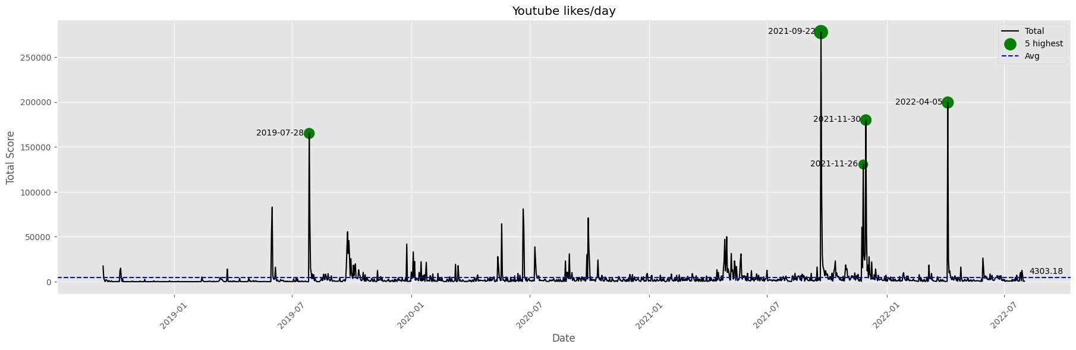
Youtube
Exploratory Analysis
No dislike button - Likes cannot be negative
Previously explored under “Top 5 Liked”
Notes:
LIKES cannot go negative, so most will near 0, so it may not be very worthwhile to investigate
CAN END HERE, THE REST ARE JUST PLOTS SINCE WE WENT OVER THE CRUCIAL EVENTS

Slide 91
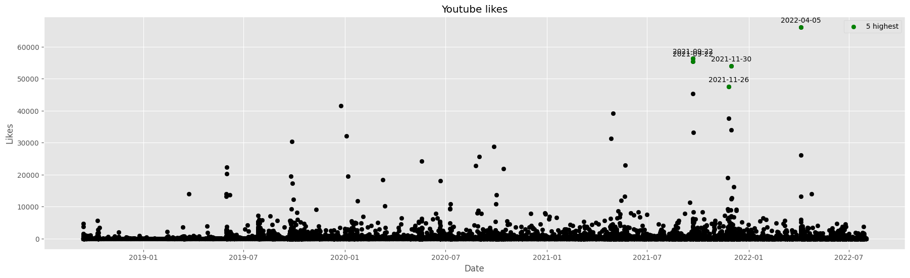
Youtube
Exploratory Analysis
Notes:
Scatterplot distribution of all comments

Slide 92
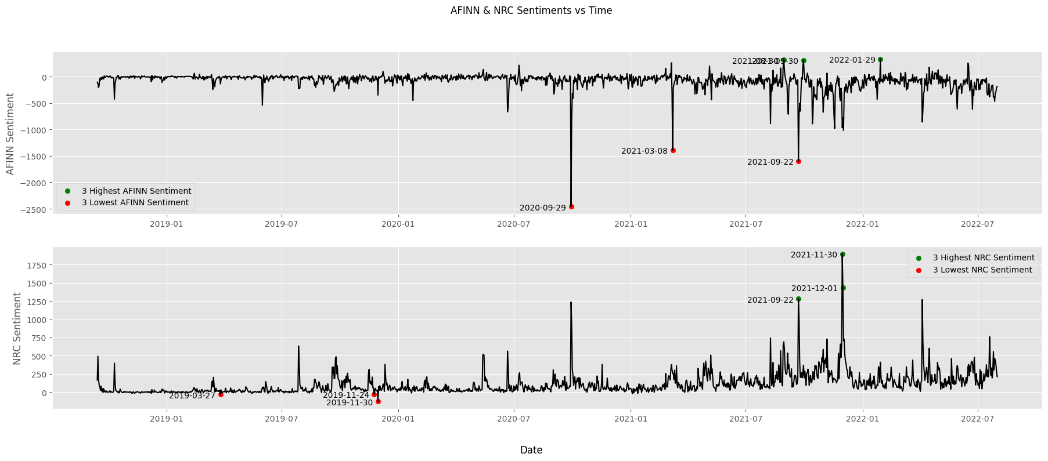
Youtube
Lexicon-based Sentiment (AFINN, NRC)
Notes:
NRC is flipped

Slide 93
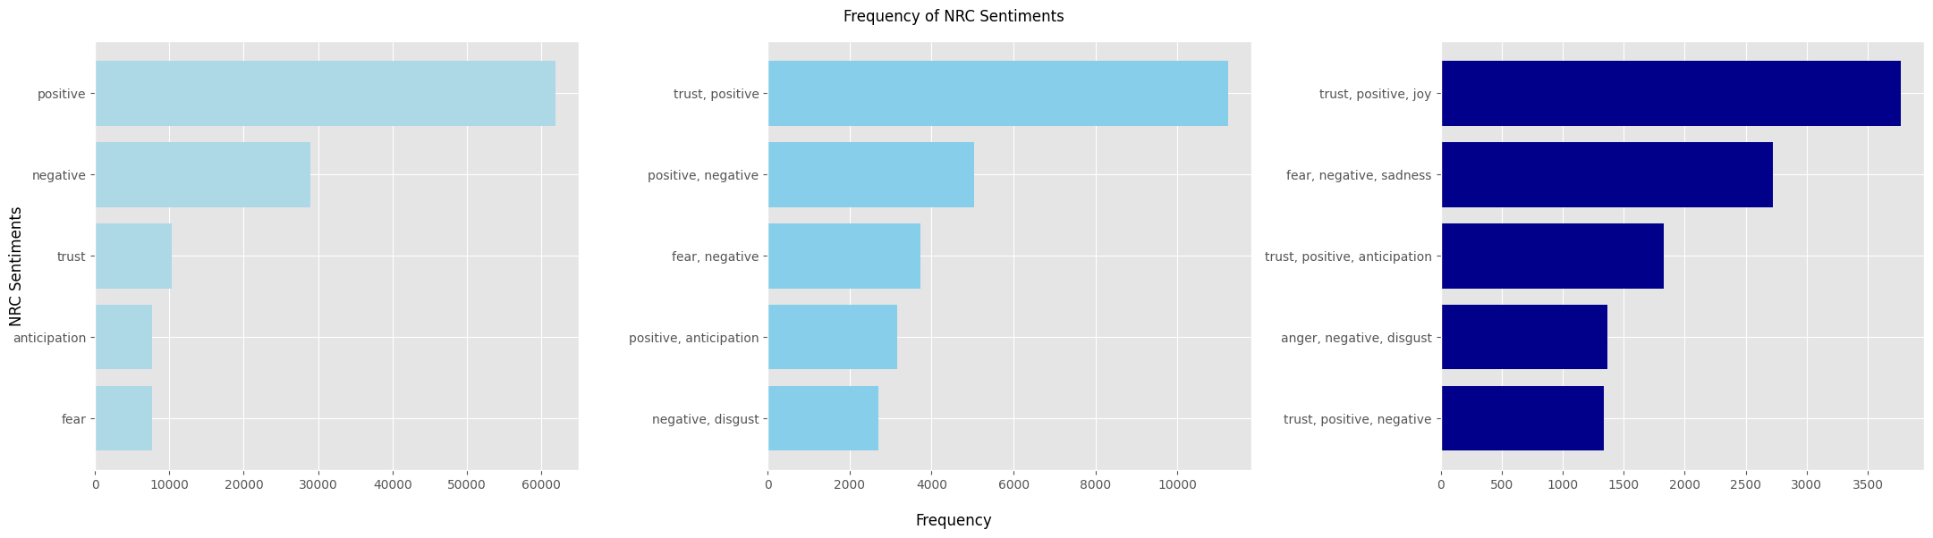
Youtube
Lexicon-based Sentiment (AFINN, NRC)
Generally more positive than negative
What’s an example of negative & disgust on climate change?

Slide 94
Youtube
Lexicon-based Sentiment (AFINN, NRC)
What’s an example of negative & disgust on climate change?
Comment_date | Comment | Likes | Reference
2020-05-15 | I am a Kolkatan and I can assure you the situation is getting worse every year. Lesser trees but more cars. Summers are getting longer and the number of cyclones are increasing like clockwork | 0 | What Will Happen if Earth's Temperature is Raised 2°C (SciShow)
2020-05-15 | I think the question should what are we ordinary people of this planet doing to slow climate change. Seeing on the news all the fireworks to celebrate New Year all around the world, though we know how much fireworks pollute the air, makes me sad, because we as people or rather majority of people are simply not willing to change and give up unnecessary things which help cause the climate change. It makes me sad because people are still ignorant, selfish and greedy and my humble opinion is that our planet is ****.. :( | 0 | What World Leaders Are Doing To Slow Climate Change (TODAY)
2022-05-15 | CRAP, GREEN ON THE OUTSIDE RED ON THE INSIDE, WATERMELON COMMIES, AGAIN CRAP | 0 | 2 Degrees Till The End | Global Warming Documentary (Science)
2021-07-25 | How does this type of flooding 😭houses handle sewage water and waste? | 0 | Climate change – living on the water (DW Documentary)
2020-09-26 | Yeah nuclear does lower co2 but it leaves behind nuclear waste plus plants take in co2 and then expell o2 | 0
Notes:
1-dimensional

Slide 95
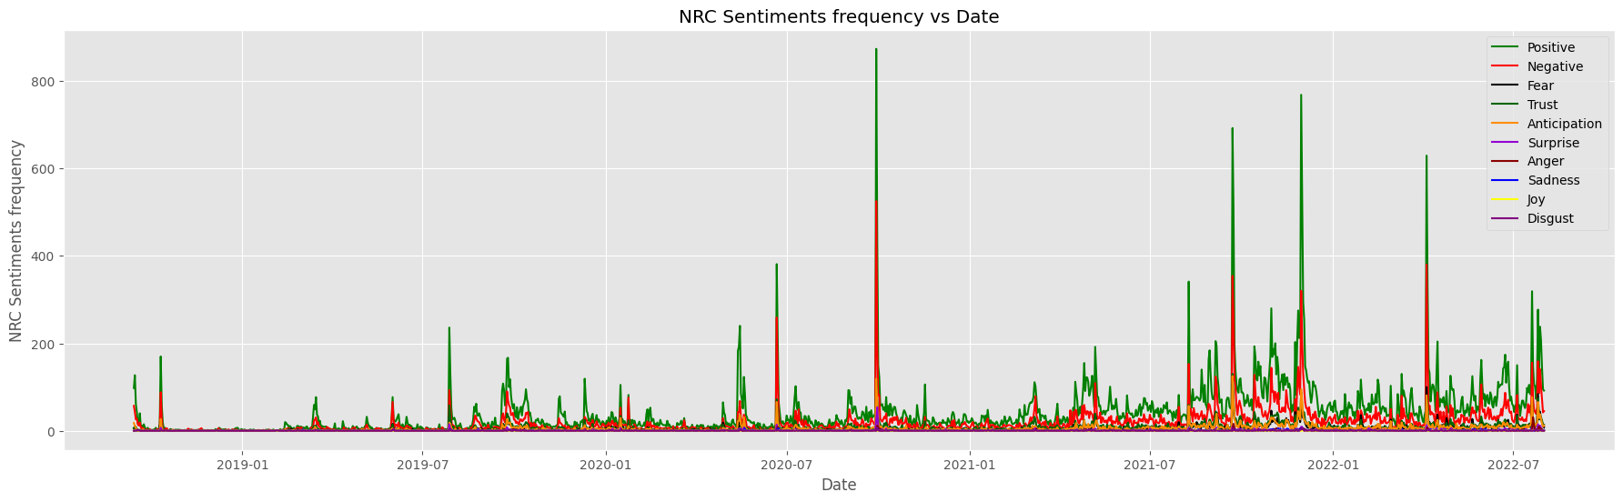
Youtube
Lexicon-based Sentiment (AFINN, NRC)
Major sentiments are positive, negative, fear in that order

Slide 96
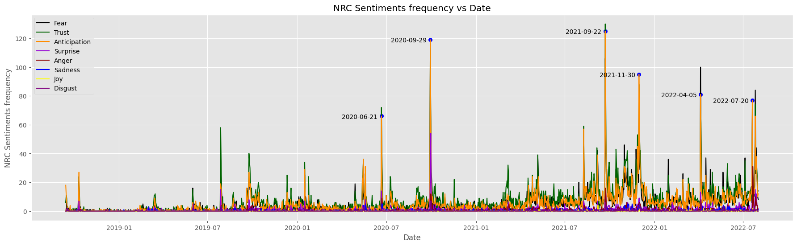
Youtube
Lexicon-based Sentiment (AFINN, NRC)
Zoom in

Slide 97
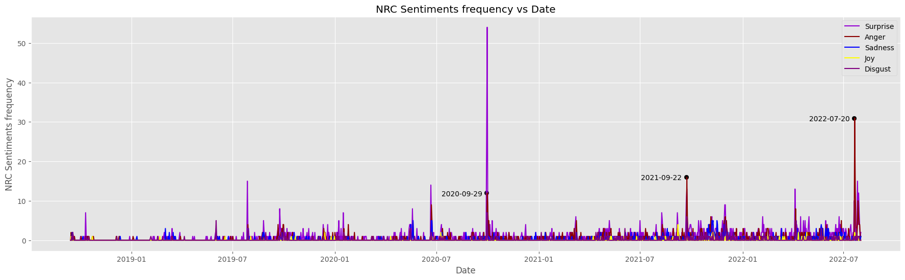
Youtube
Lexicon-based Sentiment (AFINN, NRC)
Zoom in

Slide 98
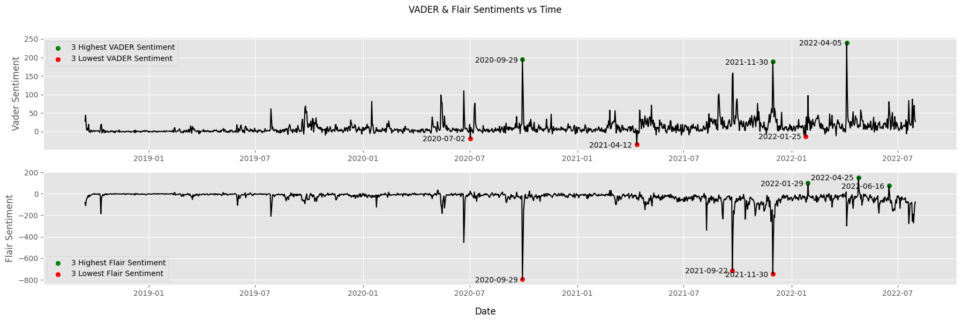
Youtube
Sentence-based Sentiment (VADER + Flair)
Notes:
Not sure why they are flipped?

Slide 99
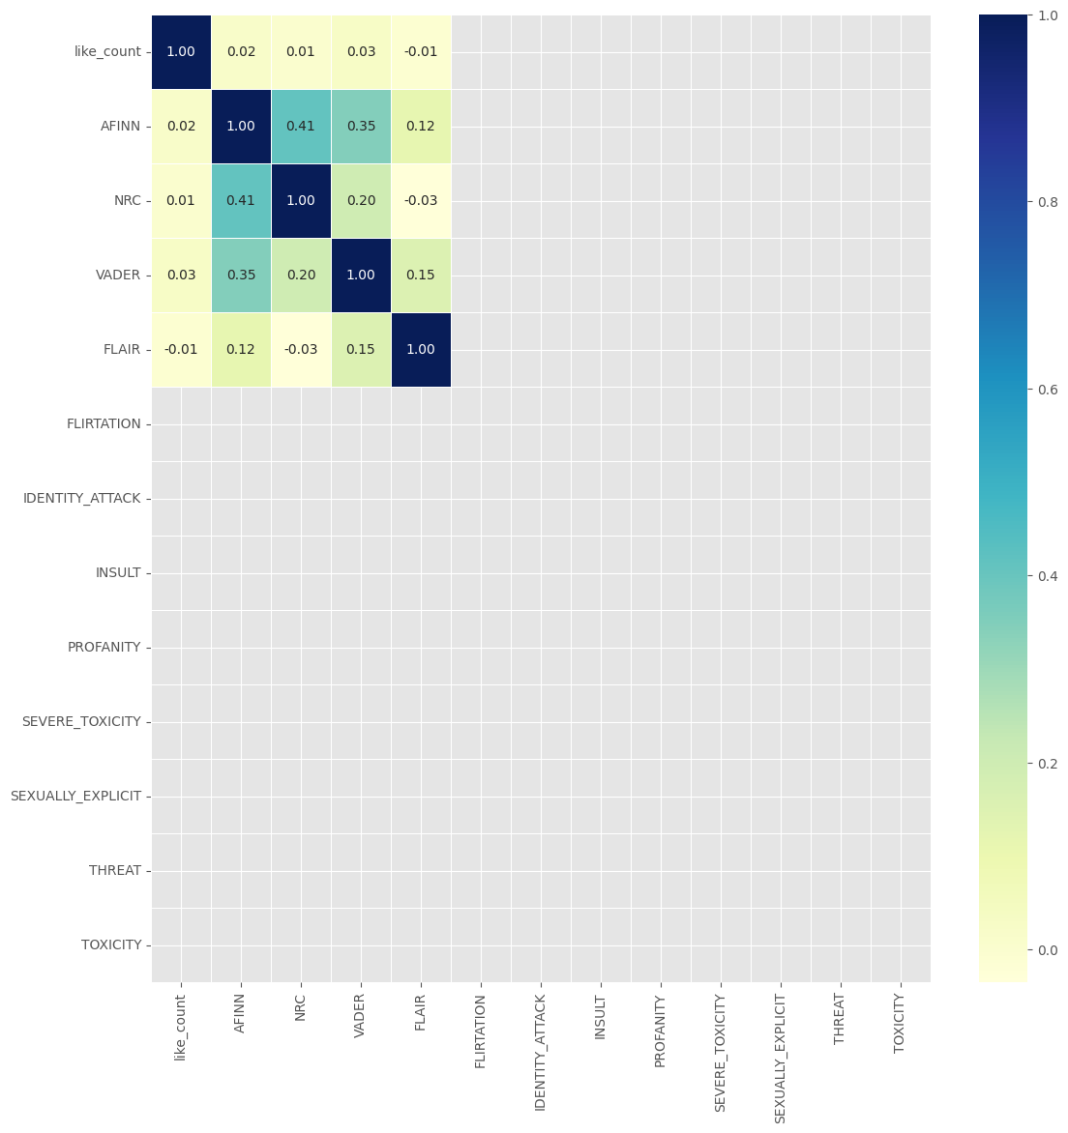
Youtube
Correlation Heatmap
Blank (NaN) for this dataset, apparently as a result of many values being the same.
Correlation formula: cor(i,j) = cov(i,j)/[stdev(i)*stdev(j)]
Notes:
The respective standard deviation will be zero and so will the denominator of the fraction. Thus, the correlation will be NaN.

Slide 100

Implementation Caveats
Duplicated comments on same + different subreddits
I did not remove any duplicated comments from the Reddit dataset, despite a non-trivial likelihood that some users would do this, to further push their point and agenda.
Implication:
Duplicated comments have the exact same sentiments, and the easiness of copy-pasting can contribute to a large volume which then artificially inflates sentiment scores, thus skewing analysis
However, keeping this data in its entirety also provides valuable insights into the prevailing 'mood' of that particular day, or exactly what these comments are pushing for.
107861 out of 3237761 are duplicates (~3%)
Improvements:
Remove duplicate comments, across all subreddits or at least the same subreddit
https://old.reddit.com/r/WayOfTheBern/comments/ggeuif/to_the_people_flooding_into_this_subreddit_trying/fq0mv82/
Notes:
3%, which I feel is tolerable, but of course zooming into smaller time frames, the impact would be more significant

Slide 101

Implementation Caveats
Lexicon-based sentiment: NRC
The highlighted part makes it such that top_NRC_emotions may be a comma-separated string Eg. “fear, positive”, somewhat similar to n-grams.
This means “fear, positive” do not contribute to each of “fear” and “positive” counts, but instead is a count by itself.
Implication:
In the example adjacent, since fear and positive are the only emotions and have equal scores, they are the top emotions for this comment
This increases proportion of “fear, positive” itself relative to either “fear” or “positive” despite including each emotion, which affects accuracy.
Improvements:
Split this row into 2 rows, with each emotion in top_NRC_emotions. The “NRC Top Sentiment” column should only ever contain 1 emotion.
“I have two rvs full of evacuees at my house for the moment thanks to CA wildfires which are partly thanks to climate change.”
NRC_emotions.raw_emotion_scores | {'positive': 1, 'fear': 1}
Notes:
Not really like n-grams, but similar in the sense that this emotion often comes with this other emotion, etc

Slide 102

Implementation Caveats
Sentence-based sentiment: VADER & Flair
The highlighted part makes it such that negative sentiments take priority over positive sentiments
Implication:
Minor implication as most comments rarely go over 200 words to be split into paragraphs and thus have more than 1 sentiment score of each type in the first place.
However, could make overall sentiment more negative and thus less accurate.
Improvement:
If abs(min) and max (opposite polarities) are equal,
Randomly choose either
Choose based on “majority win” with reference to the other sentiment columns – AFINN Sentiment & NRC Sentiment

Slide 103

Implementation Caveats
Sentence-based sentiment: VADER & Flair
The highlighted part makes it such that the most extreme/polar sentiment is taken if the comment goes over 200 words and has to be broken up into paragraphs for analysis by the sentiment models.
Implication:
Users posting comments evaluating 2 sides of an issue might have different sentiments regarding the side they write about.
This implementation simply takes the more polar sentiment, without considering that this user might actually mean the opposite.
Commonly-used “200 words” paragraphing may not work for some comments which contain a lengthier supporting argument, and may overflow into their next paragraph which contains a shorter non-supporting argument.
Improvement:
Taking the mean might prove better, since the comment would then be evaluated as a whole. However, this also increases the probability of a neutrality since opposites would cancel out. Intuitively, as sentences get longer, more neutral words/ Eg. fillers will exist, and therefore, the overall score tends to normalize more towards neutral as well

Slide 104
The Future
Youtube
Demographics data (age, gender, geographic origins)
Reveal similar or different degrees of impact of an event
Build on the Google Search Interest data
Visualize on a map
What people are saying what from where? And why?
Notes:
1. I think youtube videos have really high potential to engage with the video content itself instead of just being limited to the comment section
2. You guys might have noticed I wasn’t really able to gather the geographic origin of the users, due to limitation of the platforms these comments were posted on. Reddit doesn’t make age, gender, location information public, Youtube allows only content creators to view demographics of their own videos, while Twitter & Facebook do display these information but sadly due to the API limitations previously mentioned, we’re not able to get the relevant data.
However in future if policies or API limitations change, this data would be very useful in perhaps revealing more peculiarities or consistencies in our observations.
Additionally, I really see some potential to go deeper with the Google Search Interest data we previously covered
Most importantly, I think having this question in mind - What people are saying what from where? And why? - can help us answer a lot of questions regarding social and political issues in general and therefore also in climate change.

Slide 105
Closing
We explored…
Persona, when people think what about these persona
Different sentiment models (lexicon, rule-based + no ML (VADER), embedding-based + ML (Flair), Hate speech detection (Perspective API))
All in relation to climate change
We can glean information about the more important events in the world and we can also most certainly go in depth if we want to. Sentiment Analysis is powerful!
Notes:
We explored persona related to climate change, when people think what about these persona

Slide 106
Questions!
Notes:
Thank you! Any questions?

Slide 107
Challenges
Working with huge data
3-4 million data points for Reddit, 500k for Youtube
Memory Errors
Runtime disconnects/Execution failures => Rerun… 😭
Solutions
Actively down-casting types, storing files (.csv -> .parquet/.arrow) as more memory-efficient alternatives whenever possible
Working with lazy dataframes / chunks
Better/Faster libraries (polars > pandas), sentiment models
Working with Quota & Rate limitations
Gathering Youtube data via APIs
Perspective API
Interpretation and Representation of analysis
What sentiment analysis finds difficult to cover
Notes:
Wait for Q&A to be asked
Definitely working with the data in general, but more so with larger datasets like Reddit’s, file was about 3gb and computation times were extremely long. There were instances where my runtime either disconnected and the whole execution didn’t finish after waiting for a few hours, or just had some random timeouts that I didn’t even know was a thing. Splitting terminals and just praying often helped. So actually my computer’s the one having many sleepless nights, not me … Lazy dataframes which means not reading all the columns into memory, only those I really needed to or working with sizable chunks of the dataframe at a time
Another painful aspect was working with quota limitations, namely gathering youtube data via APIs and Perspective API. For the youtube one, there were like 140k calls or sth, and I could only use 10k per day, so I used 6 gmail accounts to get it done in like 2 days or so. Otherwise it could have easily taken me 2 weeks just to get the data. Similarly for the perspective API, but the volume of comments to analyze wasn’t as much, but it was still a bit painful
A non-technical aspect would definitely be the Interpretation and Representation of analysis. Like how would I show this, which aspects do I emphasize, which comments to pick, etc Inherent bias involved in going thru the comments, since I’m supposed to present something on climate change even while other events might be occurring in tandem with climate change We zoomed in on things that stuck out to us (peculiarities), or extremities but as sentiment analysis generally works with a lot of data, we are only able to get a breadth of knowledge and while we can certainly go in depth in smaller time periods or more specific keywords, it might be difficult to find what we want to look for, especially if trends make sense. Like we as humans tend to question why it doesn’t make sense, not why it makes sense.

